Slide 1

Covid Patient Tracker Sustainable Goal : GOOD HEALTH AND WELL-BEING
Project Mentor : Yugchhaya Galphat
Group Number : 42
Group Members : 4
1. Sakshi Rane D7B/55
2. Sanjana Asrani D7B/01
3. Divyang Patel D7B/49
4. Dimple Madhwani D7B/36

Slide 2
Content
Introduction
Problem Definition
Goals
Survey of Existing System
Limitation Existing system or research gap
Proposed System: Introduction
Architecture/ Framework (Block Diagram, Conceptual Diagram, ER Diagram)
Algorithm and Process Design
Details of Hardware & Software
Methodology employed
Next Work Plan
Conclusion
References

Slide 3

Introduction to Project
The coronavirus pandemic has taken the world by storm with its rapid growth and spread.
Thus to analyze what has been its impact so far and analyze the outbreak of COVID 19 across various regions, visualize them using charts and tables, and predict the number of upcoming confirmed cases,we have built a simple user friendly website which will be showing the current status of the virus.
Hence with a few safety measures, and updates , you can take care of yourself and your loved ones from getting adversely affected in the hour of crisis.

Slide 4
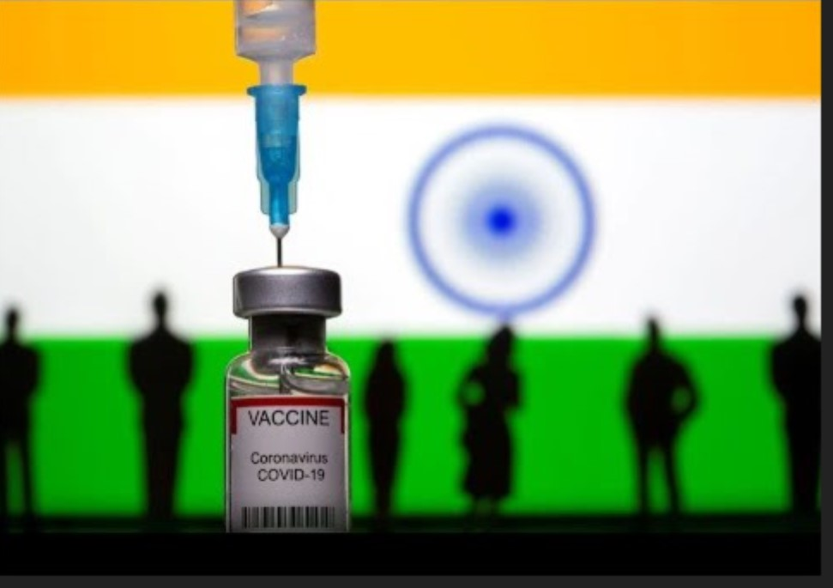
Problem Definition
Analysing the present situation in India.
Visualize the data and respresent it using graphs and pie charts.
Show news updates about the current situation.
Perform a self diagnosis based on the questionnaire.

Slide 5
Goals
To track the COVID patients.
To Maintain the statistical data of the active cases,recovered patients and the vaccinated ones.
To provide data and updates about the current situation, thereby helping in analyzation of the extent of COVID-19.
Provision for emergency help.

Slide 6
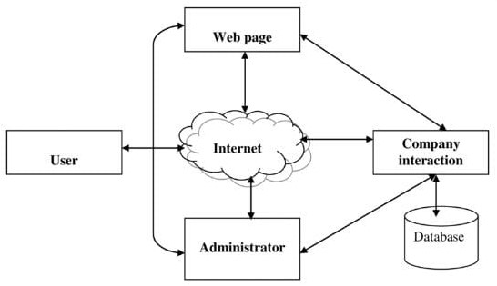
Architecture/ Framework (Block Diagram, Conceptual Diagram, ER Diagram)
PROPOSED SYSTEM :

Slide 7
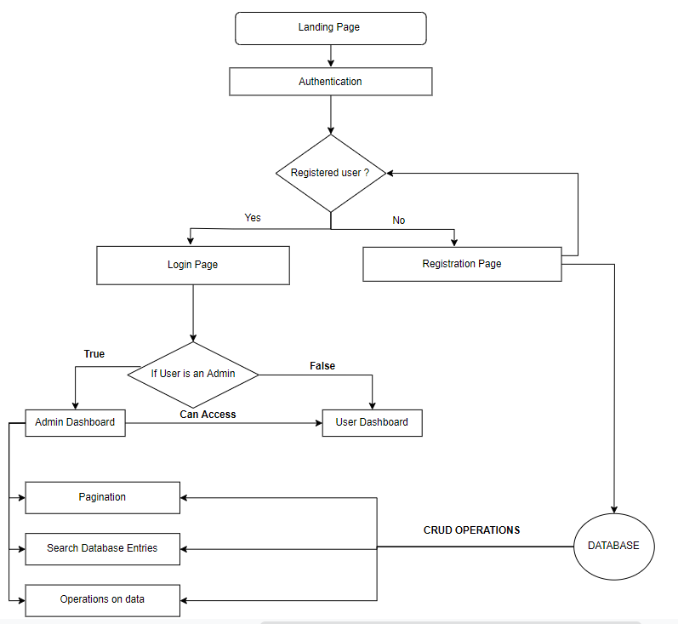
Flow of the website :

Slide 8
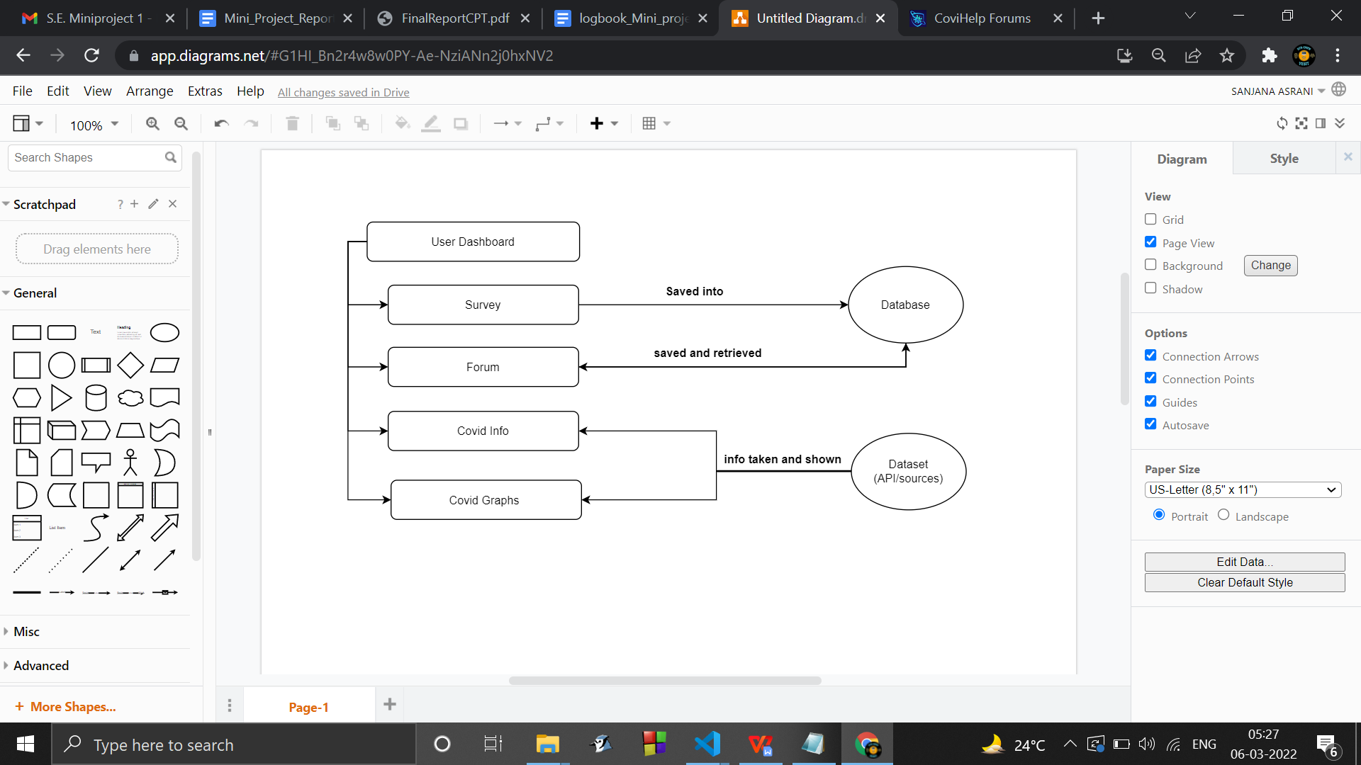
flow of the user page :

Slide 9
Methodology : Algorithm and Process Design
Data Source :
Data is extracted from verified sources such as WHO. The sites reported confirmed.
COVID-19 cases, as well as recovered and deaths for affected countries and regions.
Data Visualization :
The data collected in CoronaTracker is available on data lakes platform.
The fetched data will be stored in relational database, MySQL. The data mostly will be
stored in raw format before being aggregated for visualization.
Web Development :
Developing web pages and then integrating into a website : consisting of visualization
model displaying facts and figures on current covid cases.
❖ User Interaction :
Developing a page using mainly php where the users can come and talk , maybe about the website , perhaps want to share their covid experience or maybe give feedback .

Slide 10
Hardware, Software, Tools and constraint
HARDWARE :
Processor: Intel i3 or AMD
equivalent.
Disk space: 4GB
RAM: 8GB
GPU: Nvidia GPU
SOFTWARE:
HTML , CSS , BOOTSTRAP
PHP
MYSQL
JAVASCRIPT

Slide 11
Next Work Plan
Implementation and testing of the proposed system which will forecast COVID-19 cases, deaths, and recoveries

Slide 12
MINIPROJECT REVIEW 2
WORK PERFORMED TILL DATE :
1. Data Extraction from https://covid19.who.int/info/ Successfully performed .
2. Data sorted using JavaScript successfully Performed.
3. Graphs were successfuly made using the above dataset using chart.js
4. An html website , consisting of many linked webpages is made using html , css , js.
5. Our (Registration form) Input form has been connected to a php database . When we press Submit , the user input gets stored in the database.
6. We made a survey form which gives a suggestion based on the severity of symptoms.

Slide 13
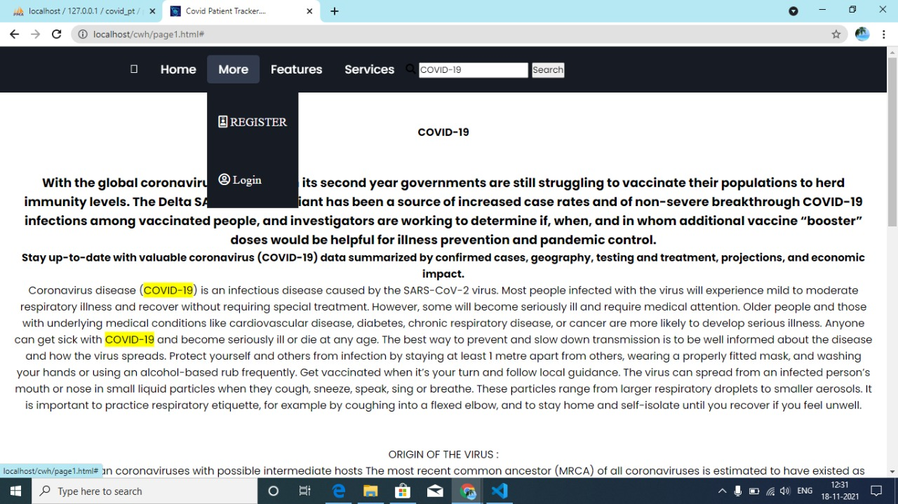
HOME PAGE

Slide 14
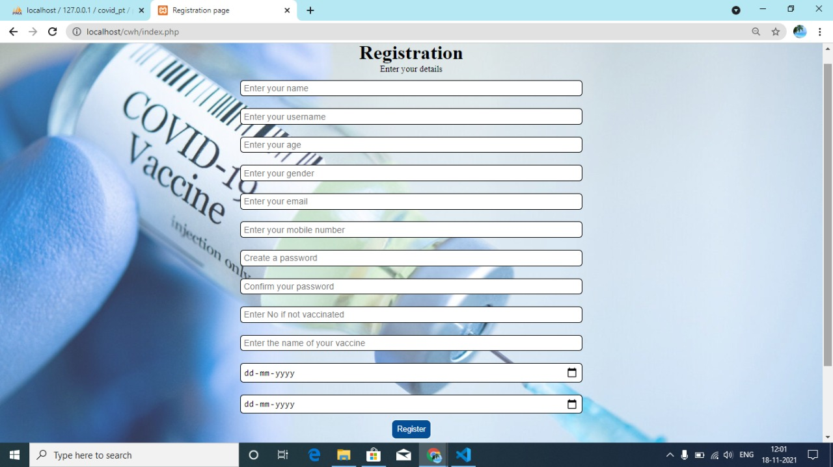
REGISTRATION FORM

Slide 15
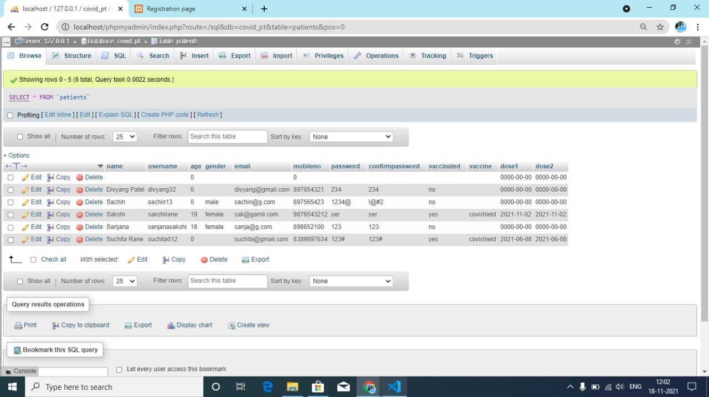
DATA BASE

Slide 16
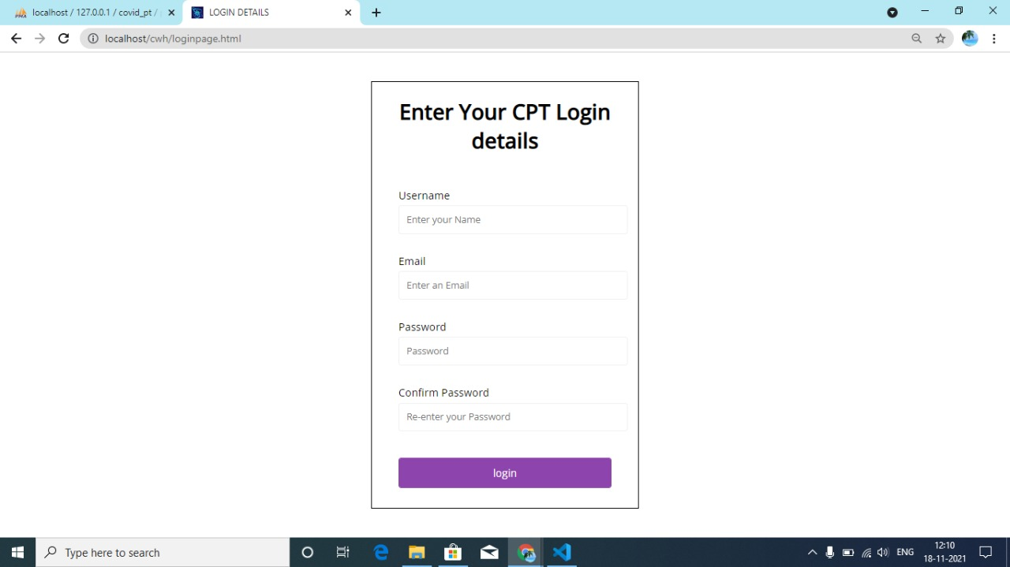
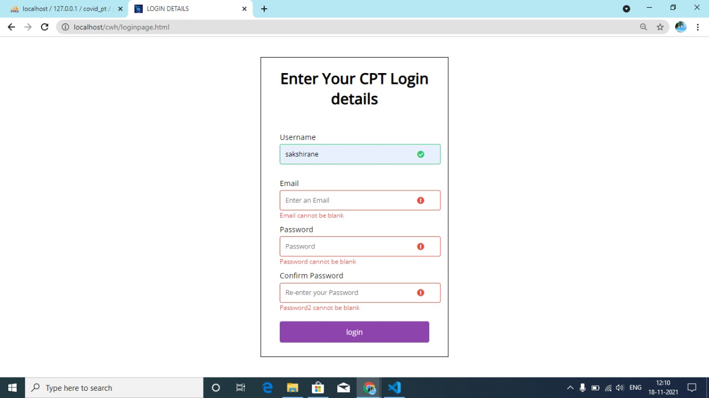
LOGIN PAGE :- VALIDATED LOGIN PAGE :-

Slide 17
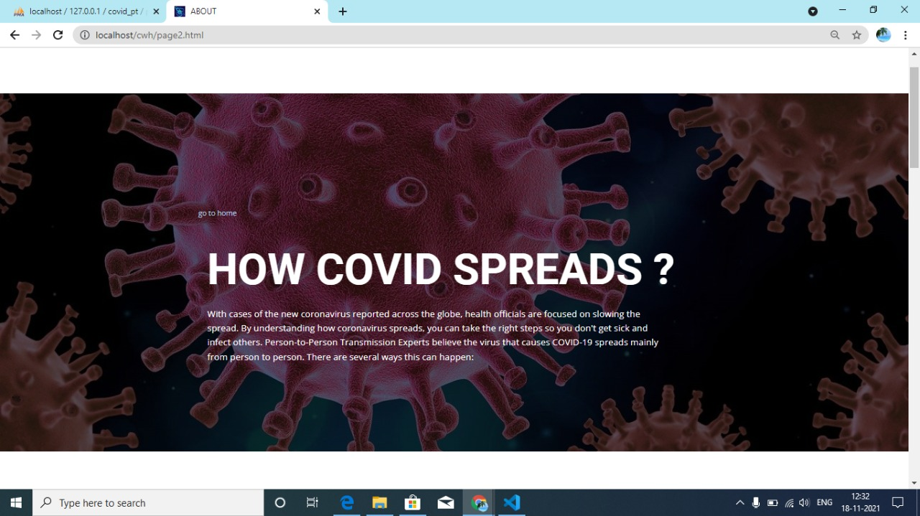
LINKS

Slide 18
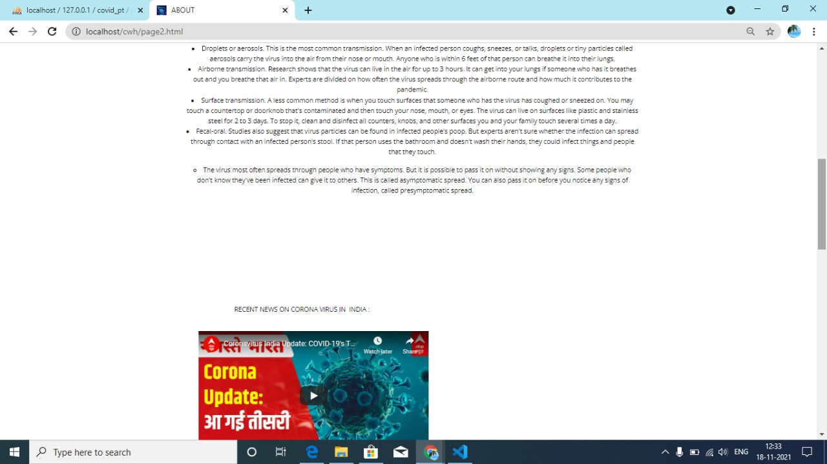

Slide 19
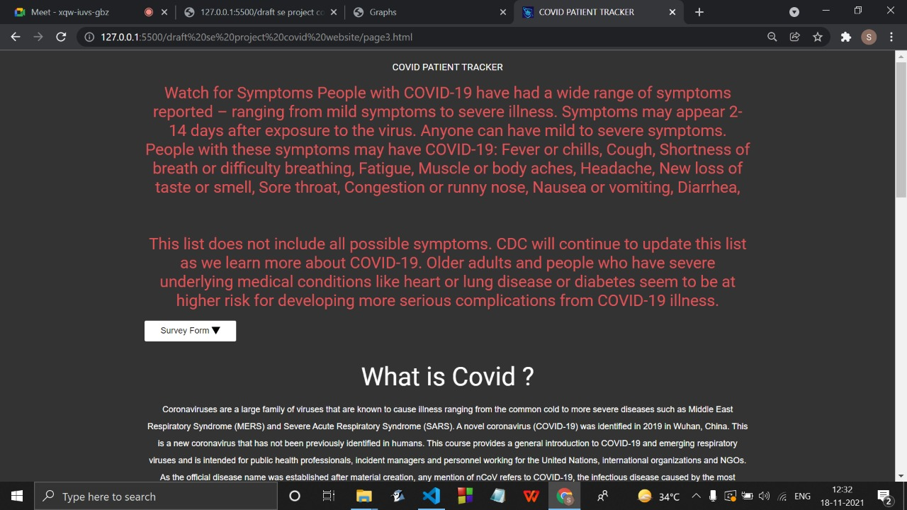

Slide 20
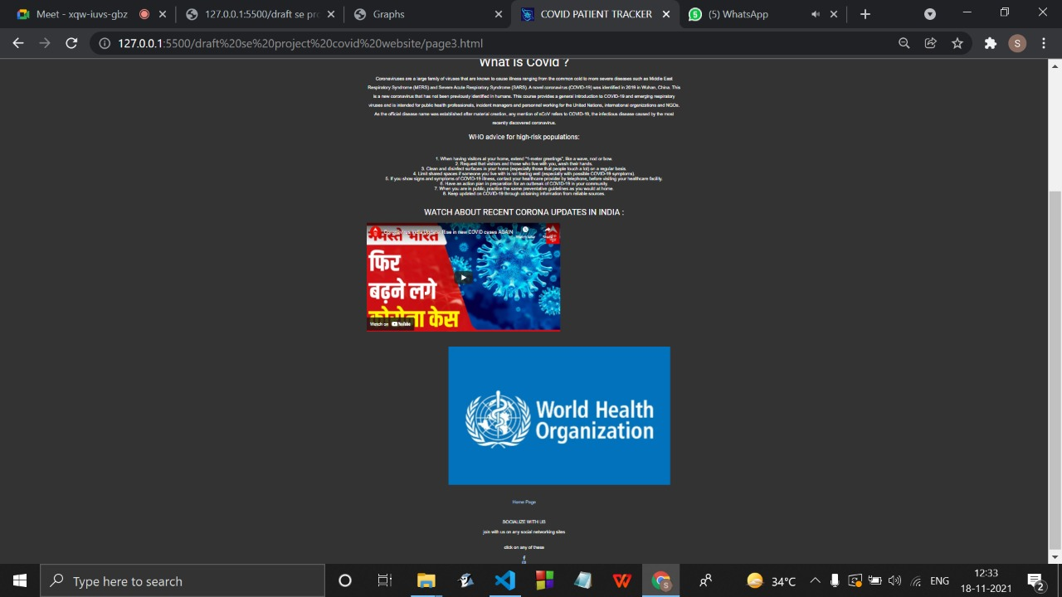

Slide 21
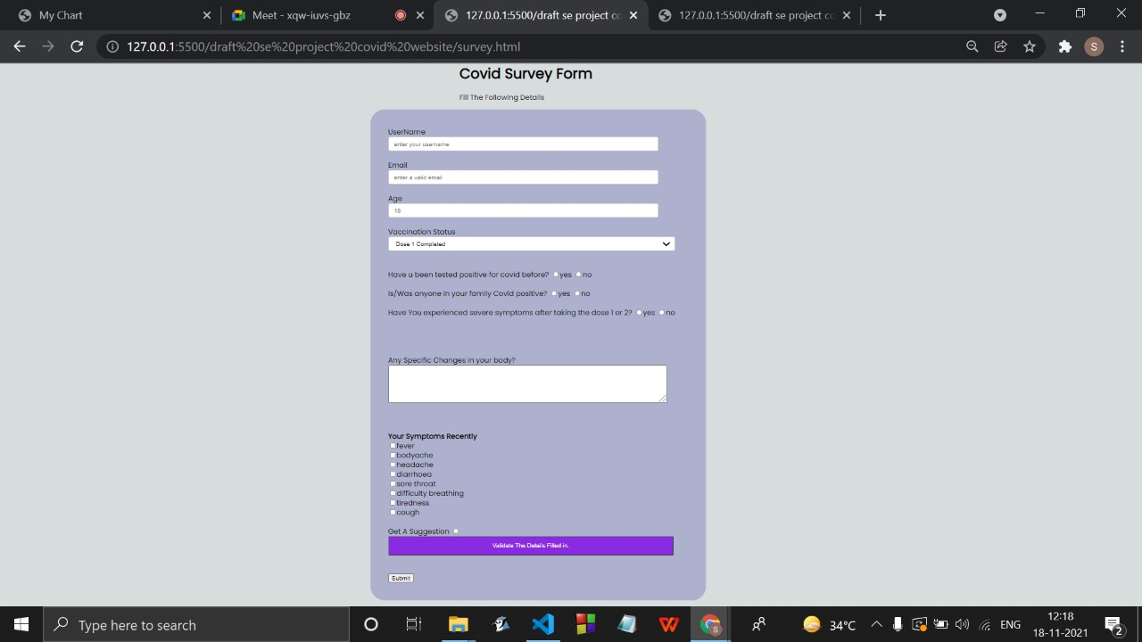
SURVEY FORM

Slide 22
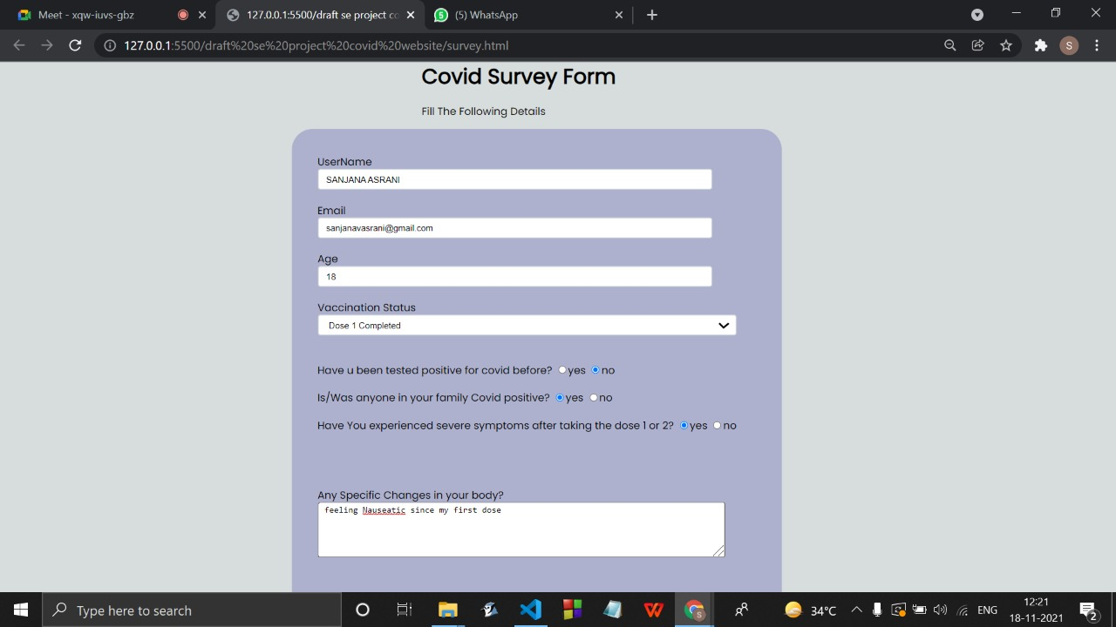

Slide 23
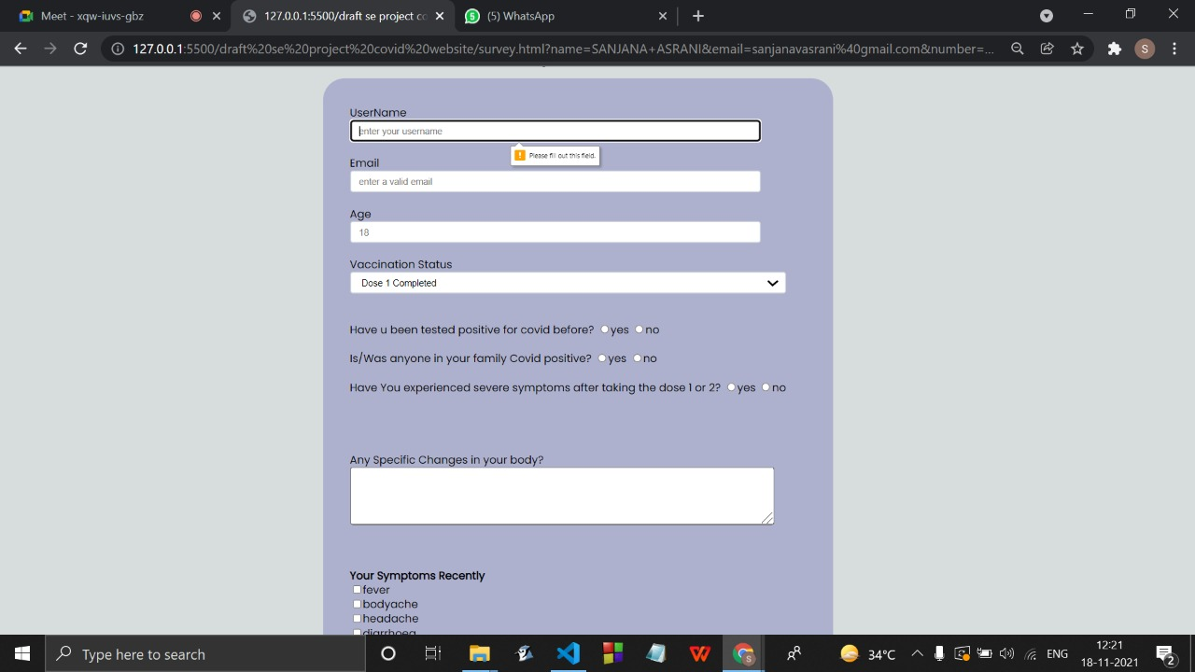

Slide 24
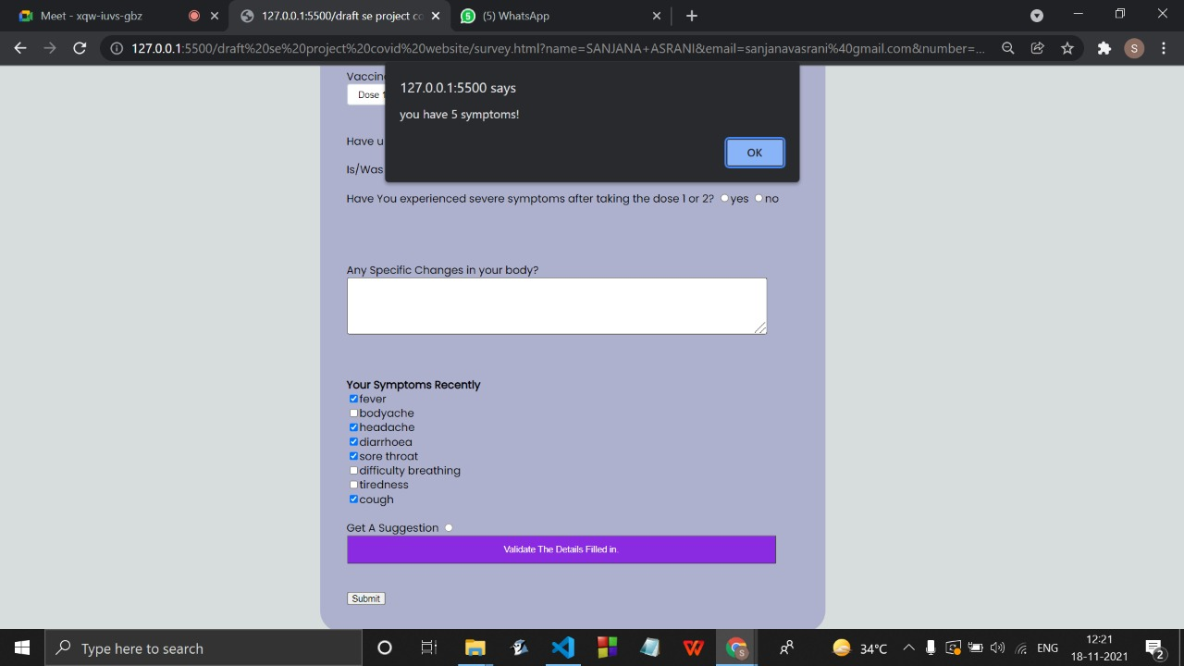

Slide 25


Slide 26
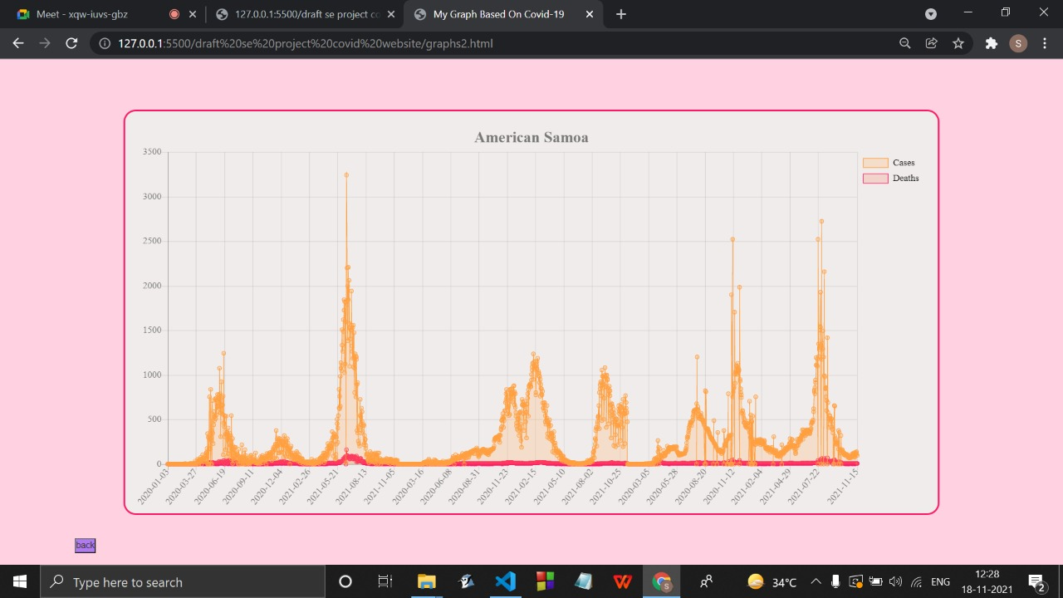
GRAPH

Slide 27
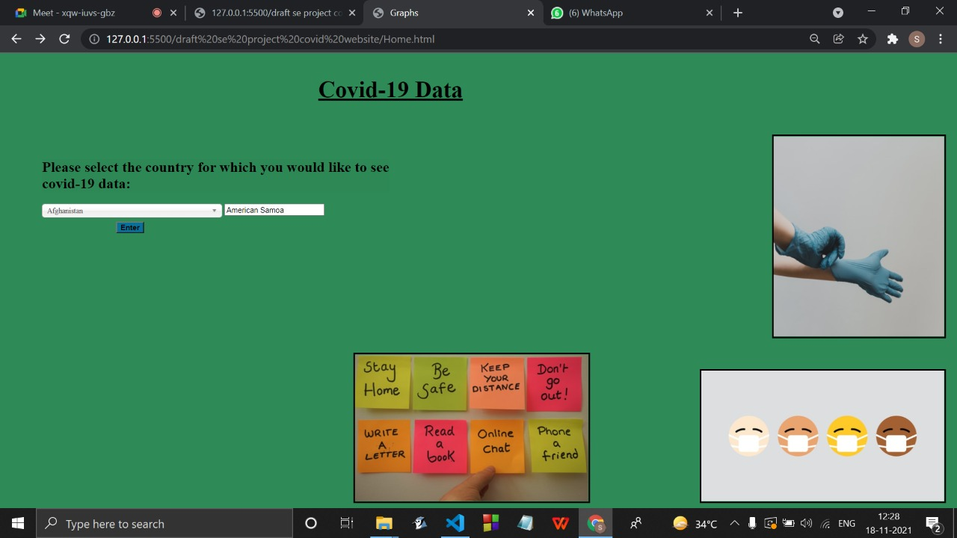

Slide 28
NEXT WOK PLAN:
. We will aim to perform operations on the data stored in the database through Registration forms for eg. retrieving the data and to enhance the data visualization.

Slide 29
FINAL PRESENTATION (Sem III) :
Work Implemented :
Performed CRUD operations that are Create a Database , Read the database entries and print them as a table , Update the database entries , Delete the entries .
Connected the Survey form with the pre-existing database of login and registration.
Added More Pages and improved the website layout .
Created an Admin Page and added some functionalities only admin has .

Slide 30
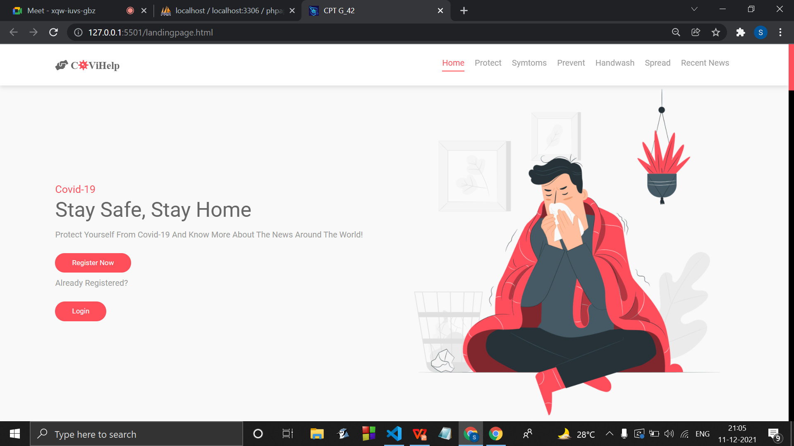
Landing Page of the CPT website

Slide 31
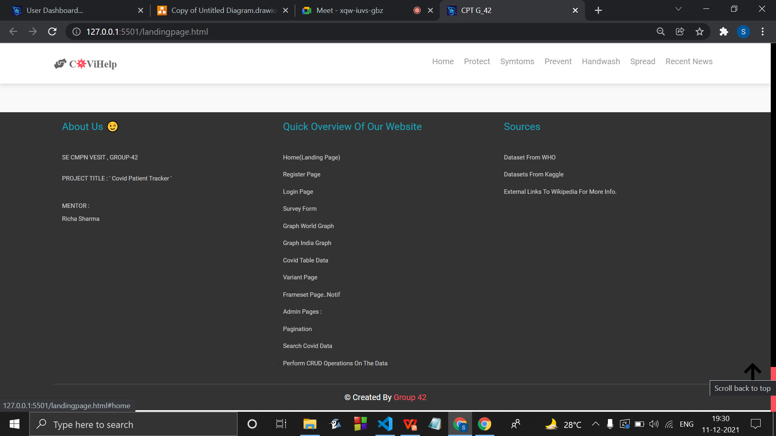

Slide 32
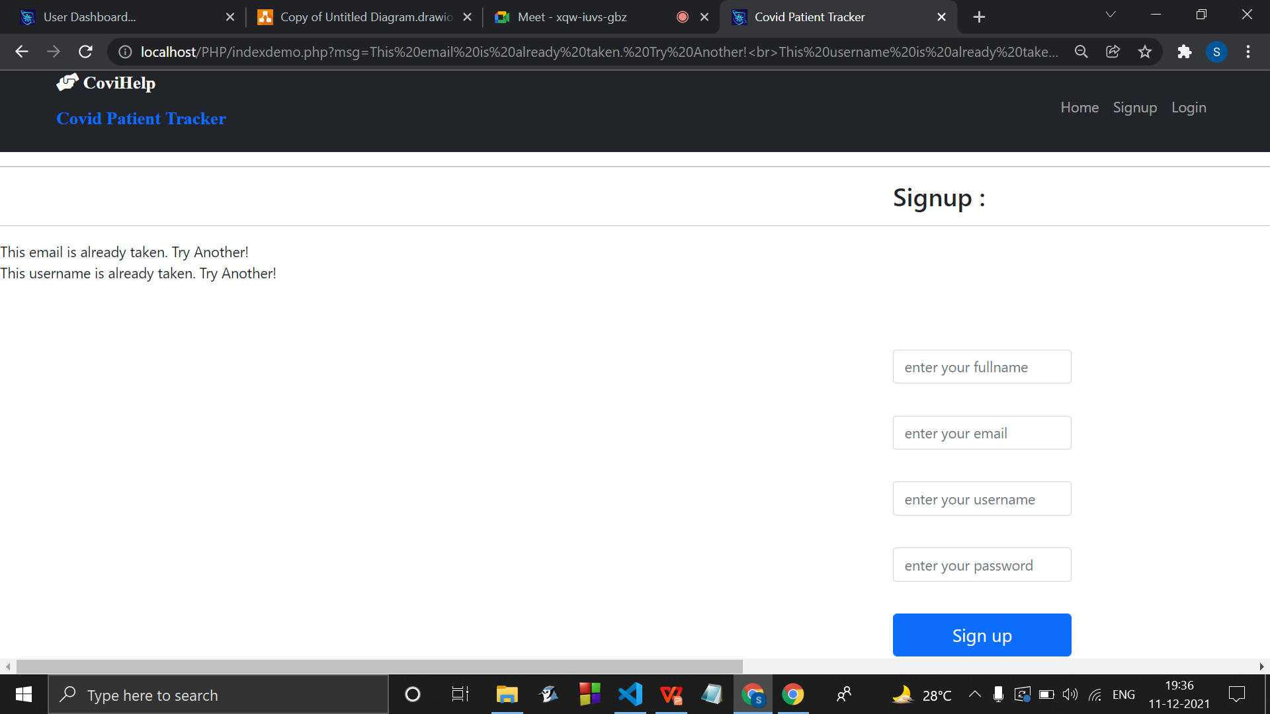
Registration Page :
( with validations of empty fields and if username/email already exists )

Slide 33
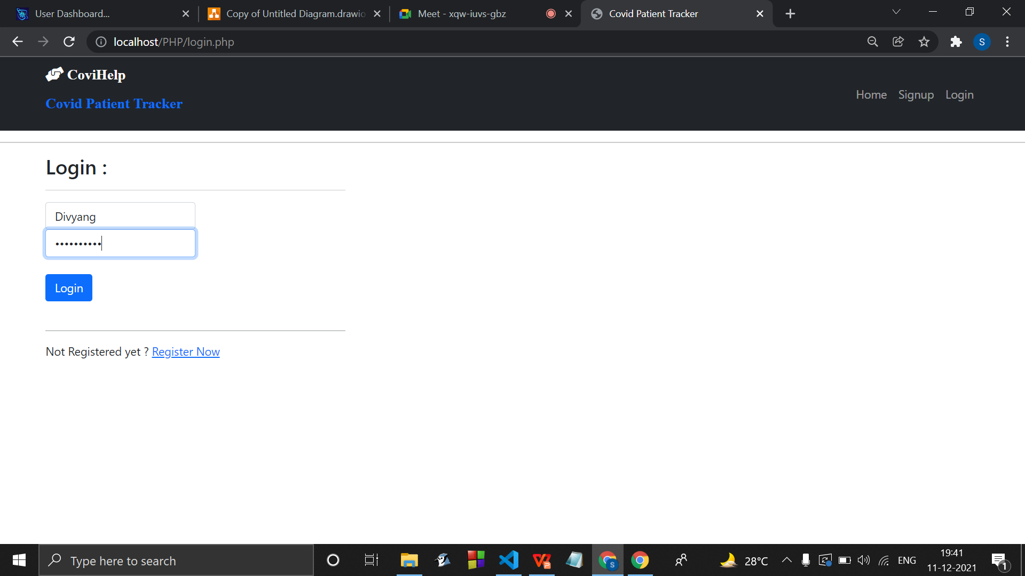
Login Page

Slide 34
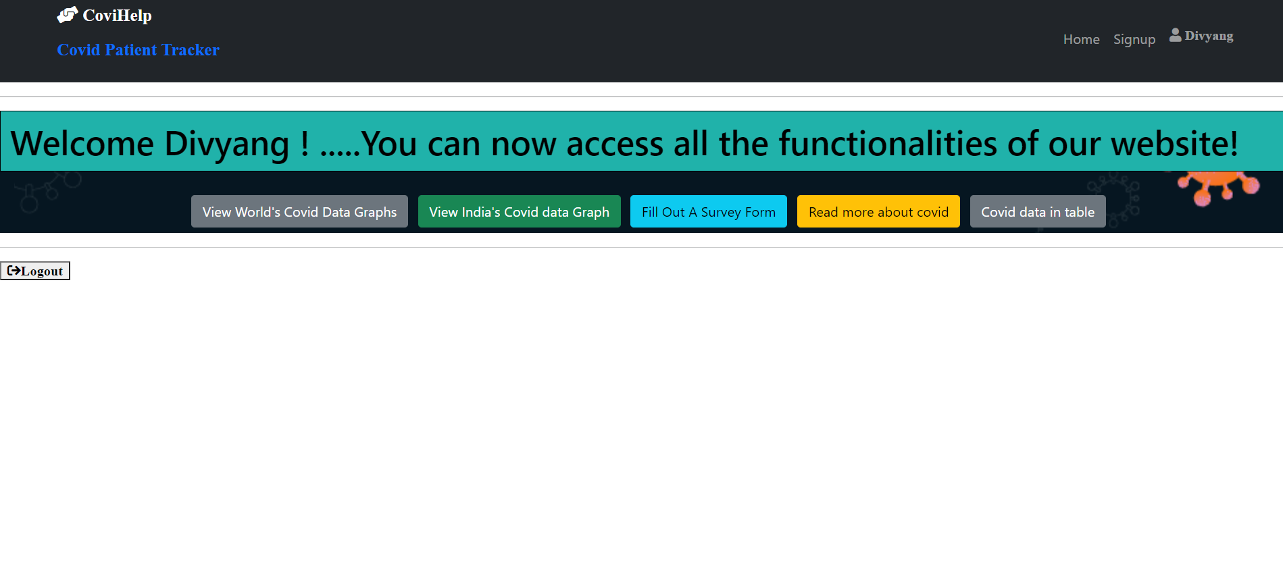
User Dashboard
Dynamic Dashboard - Showing the Username on the top right :

Slide 35
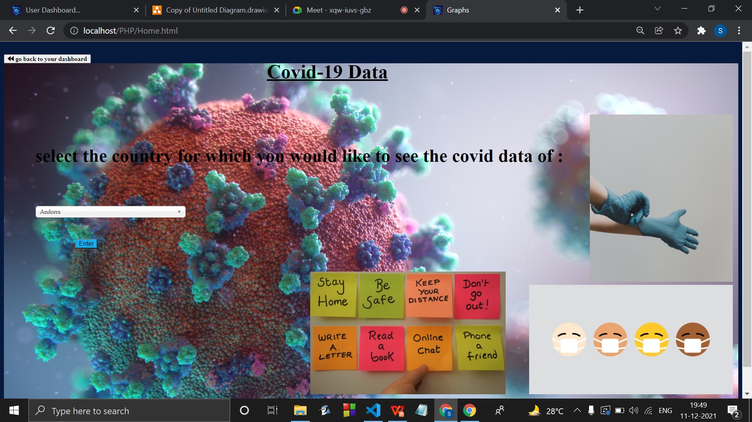
Viewing Covid Countrywise Data Graph :

Slide 36
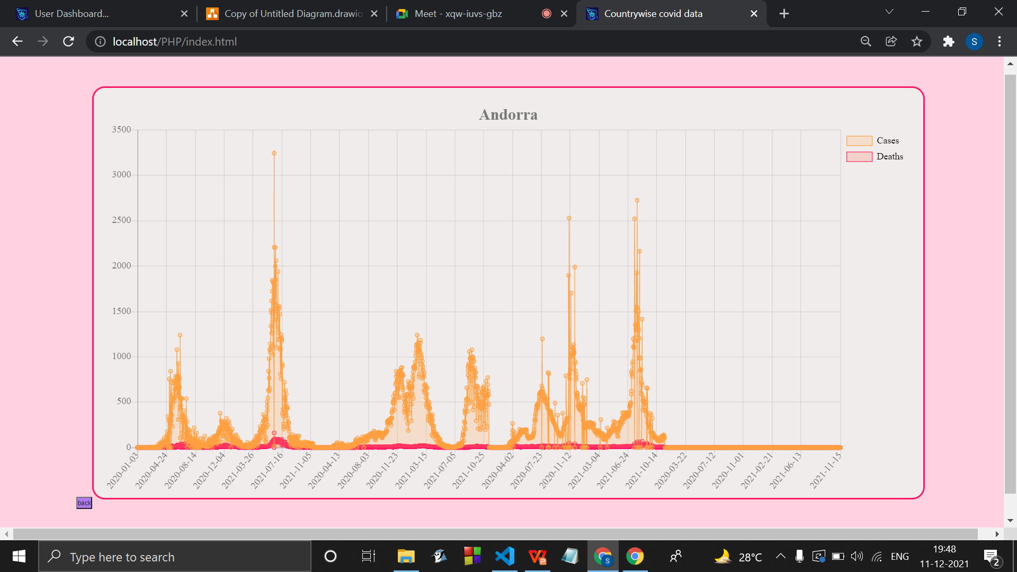
Graph being plotted :

Slide 37
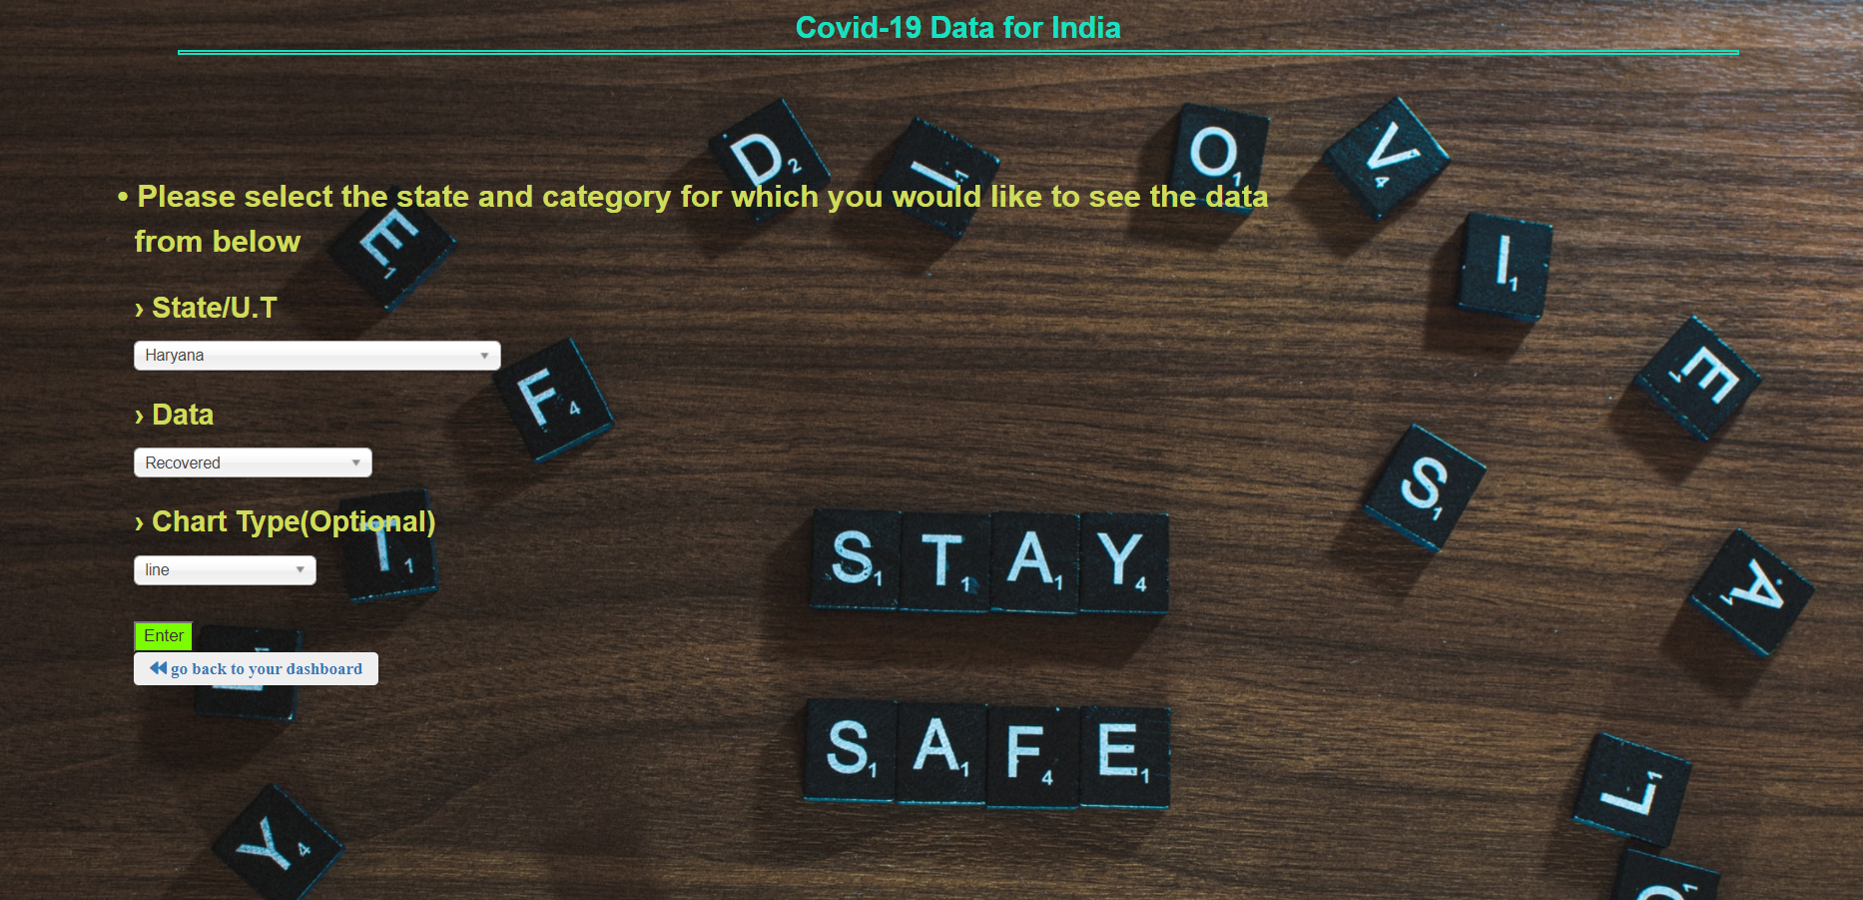
India’s Covid data graph :

Slide 38
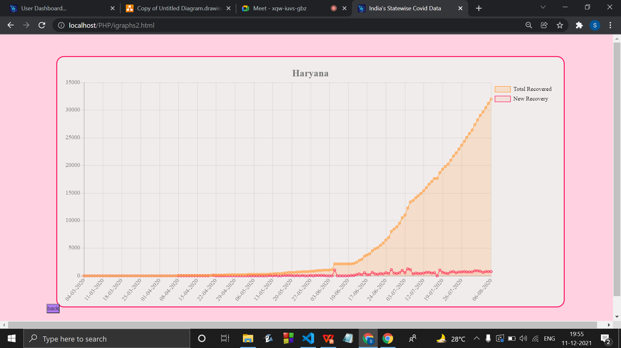
Graph being plotted ..

Slide 39
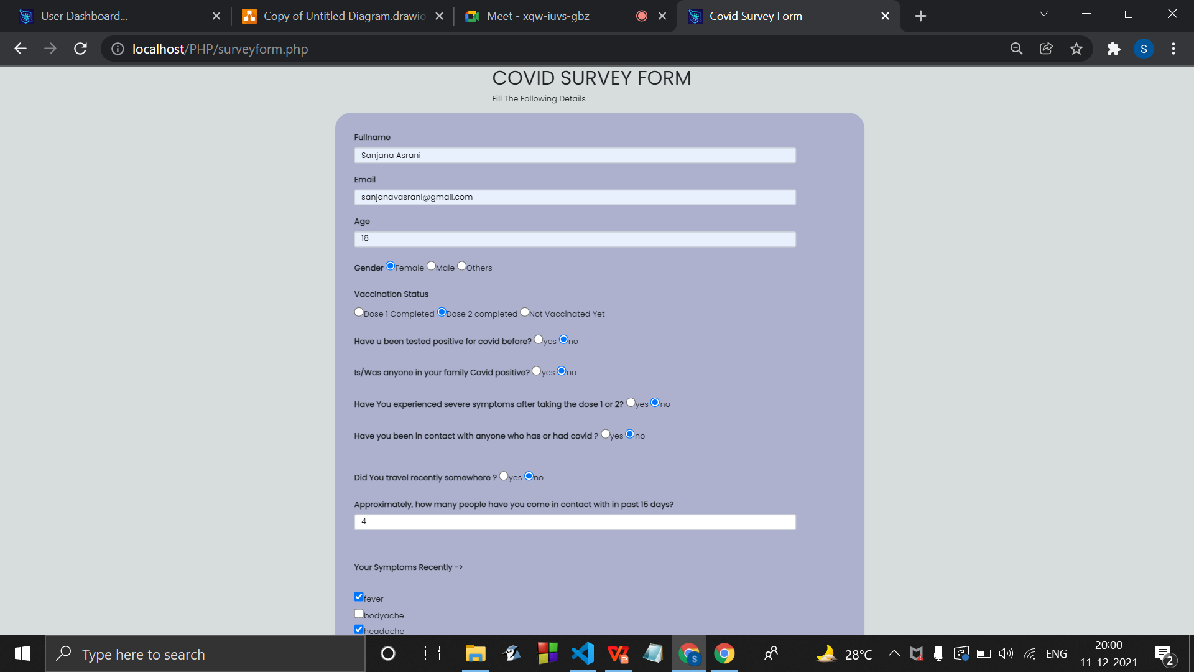
Survey form

Slide 40
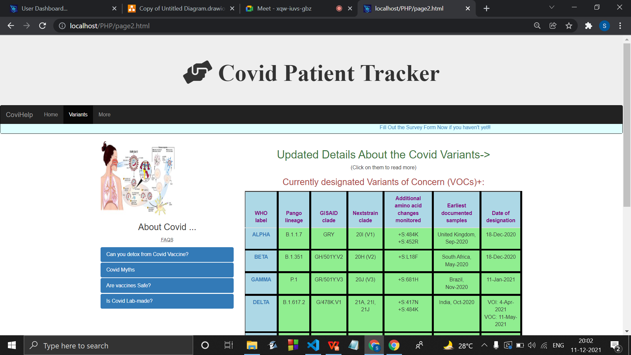
Covid Variant info :

Slide 41
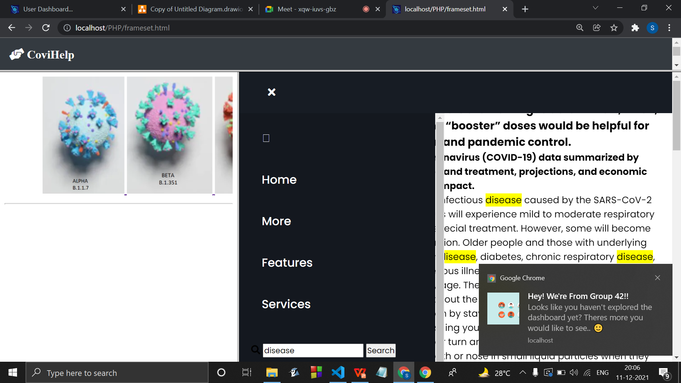
working search bar with a notification as soon as user visits the website.

Slide 42
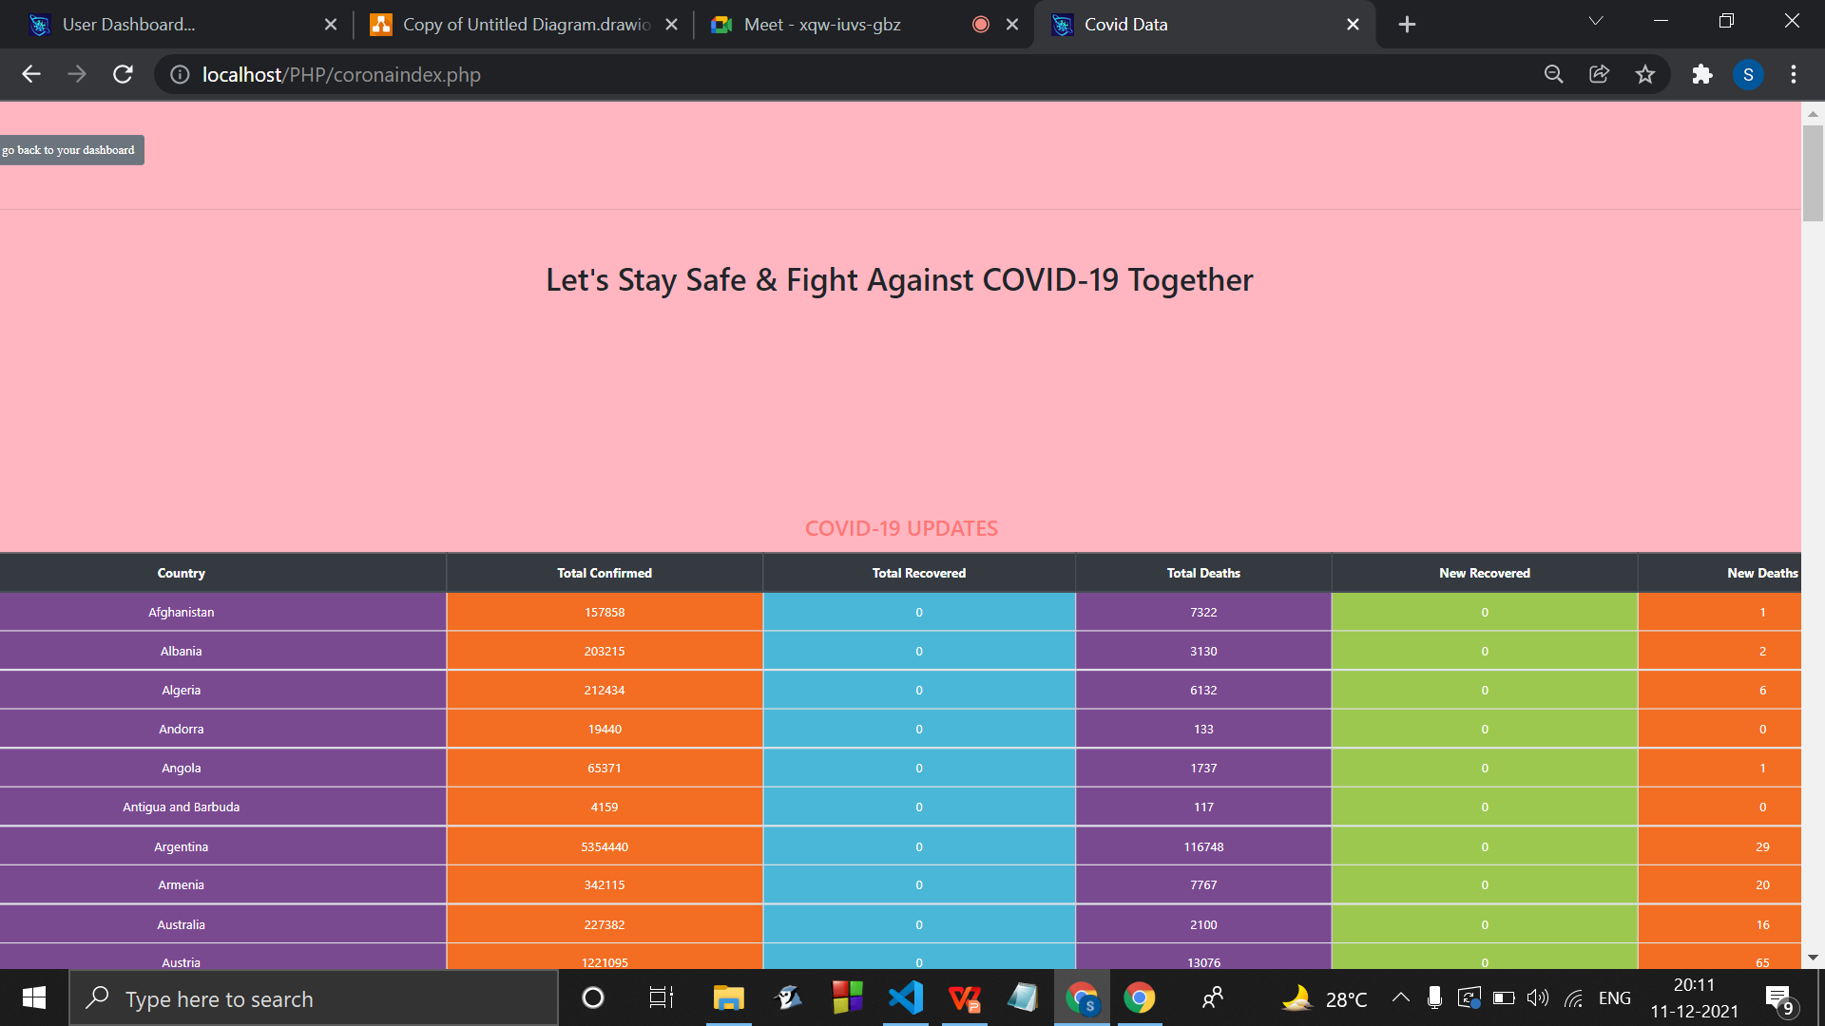
Viewing the Data from an api in a table :

Slide 43
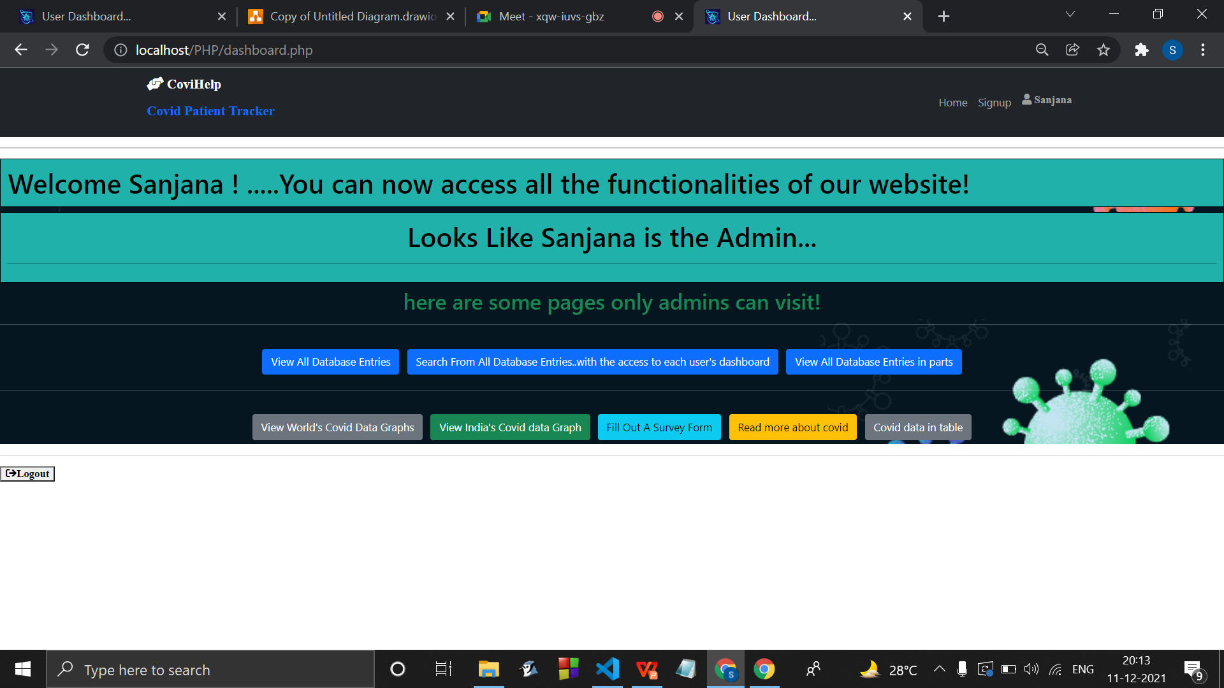
If the User in an Admin :

Slide 44
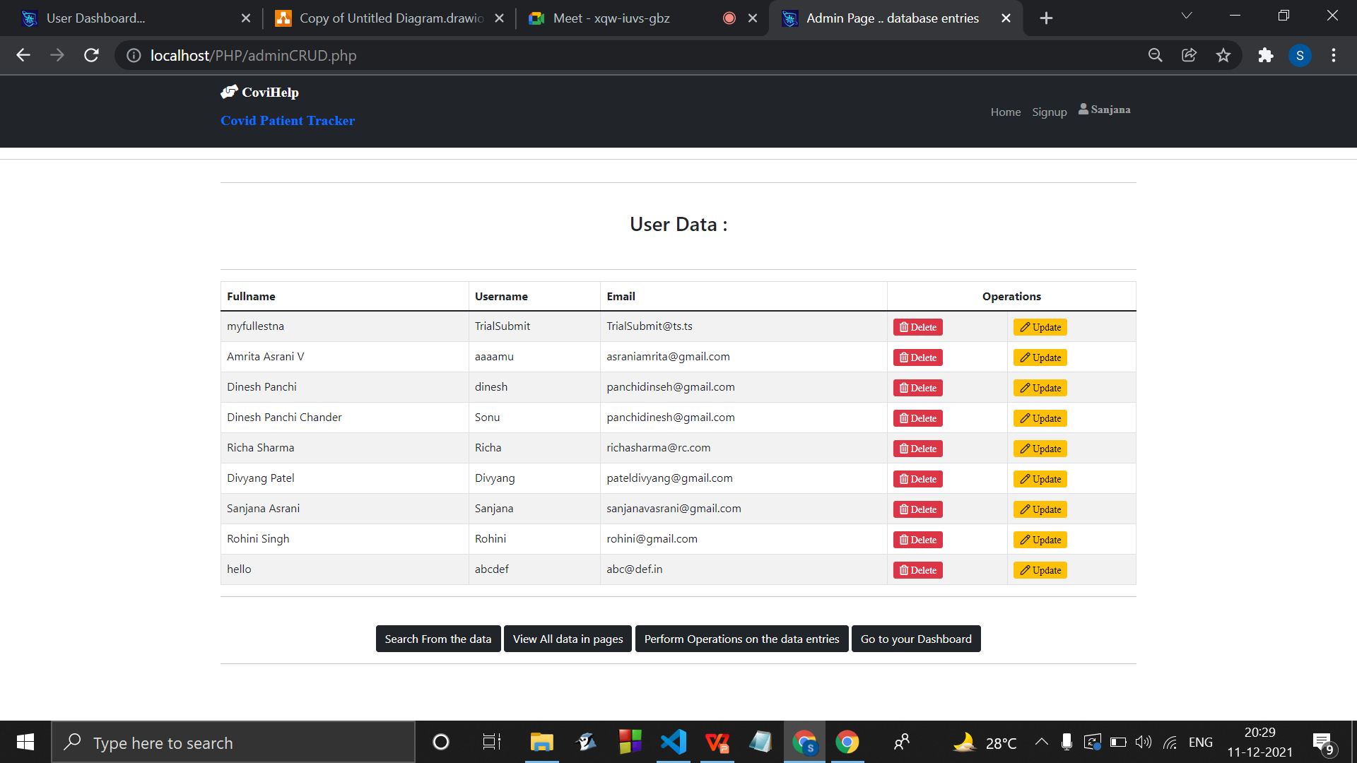
Performing CRUD operations :

Slide 45
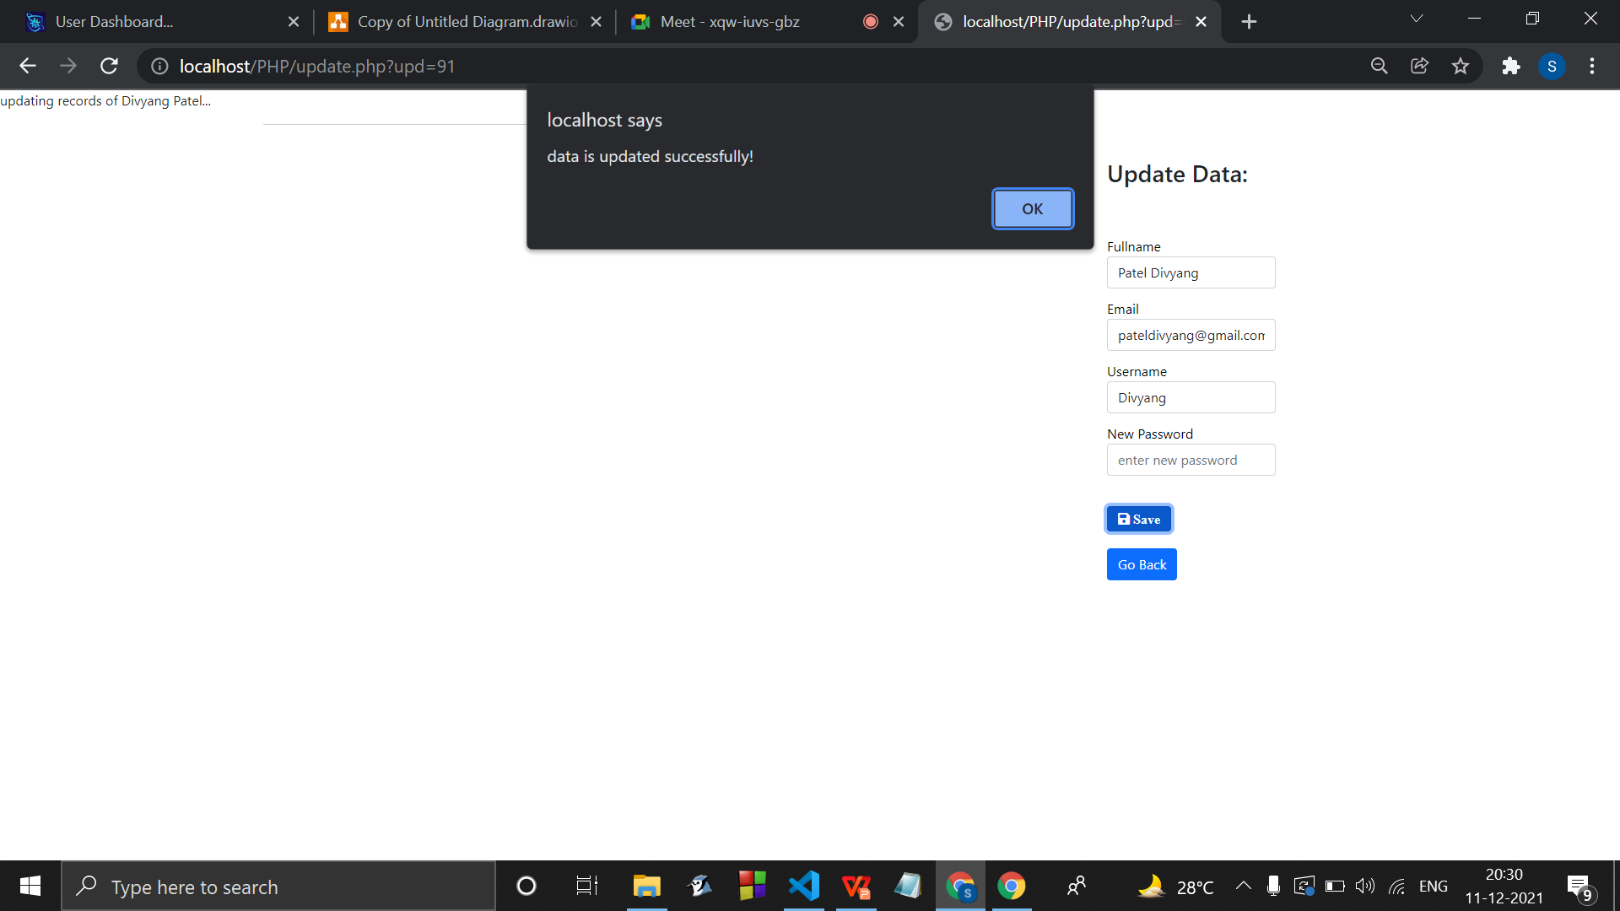
Updating the data

Slide 46
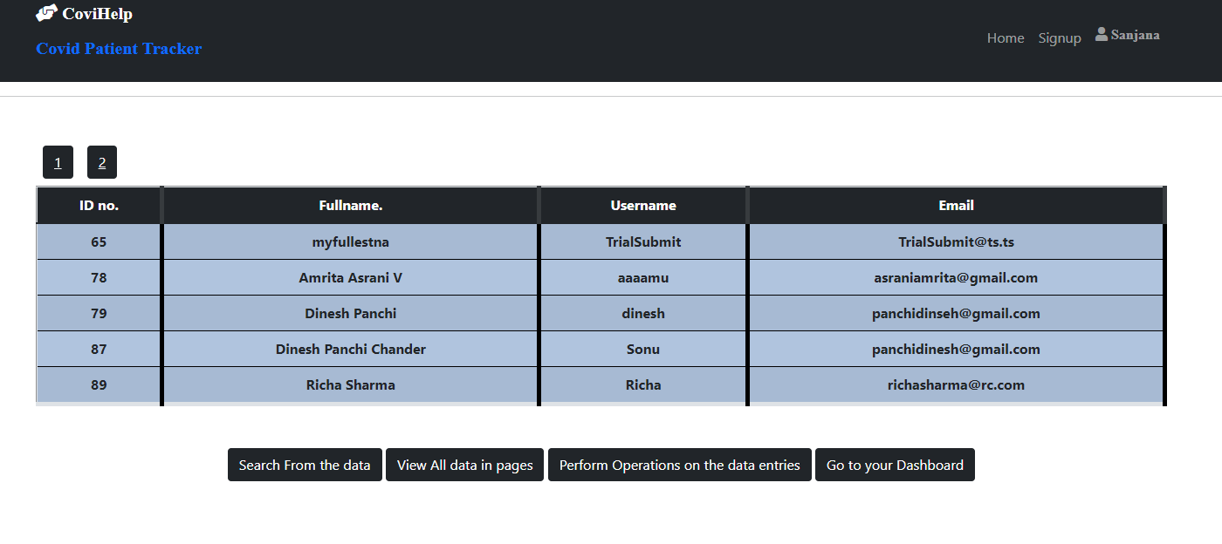
Pagination

Slide 47
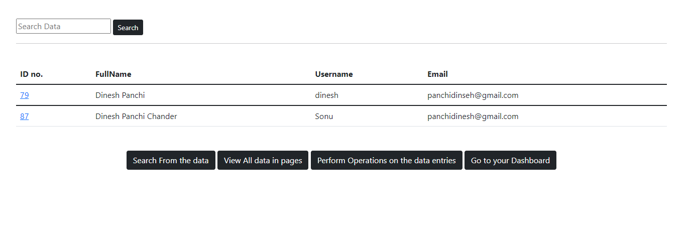
Search from the database :

Slide 48
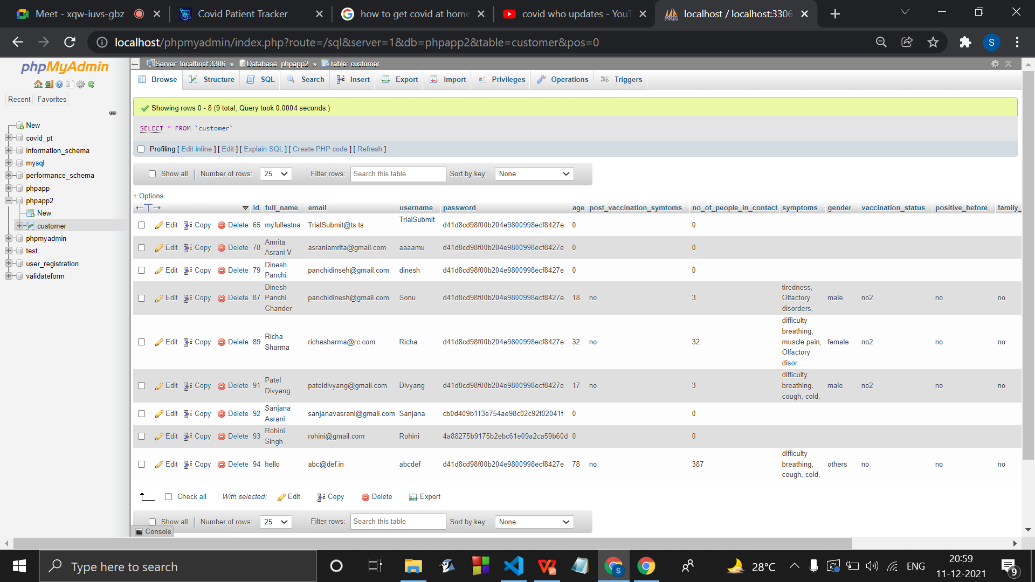
Our database :
The newly Registered users or the users who haven’t filled the survey form yet , have 0 or empty entries in the columns of survey form.

Slide 49
References
The Government of India. 2020. Live updates from Worldometer. Retrieved from https://www.worldometers.info/coronavirus/
country/india/.
World Health Organization. 2020. Coronavirus disease 2019 (COVID-19): Situation report. Retrieved from https://www.worldometers.info/coronavirus/?utm_campaign=homeAdvegas1?%20.
Alan L.Portal, Yi Zhang, Ying Huang, Mengjia Wu.Tracking and Mining the COVID-19 Research Literature. Retrieved from https://doi.org/10.3389/frma.2020.594060

Slide 50
Fairoza Amira Binti Hamzaha, Cher Han Laub, Hafeez Nazric, Dominic Vincent Ligotd, Guanhua Leee, Cheng Liang Tanf, Mohammad Khursani Bin Mohd Shaibg,Ummi Hasanah Binti Zaidonh, Adina Binti Abdullahi, Ming Hong Chungj, Chin HweeOngk, Pei Ying Chewl and Roland Emmanuel Salungam. CoronaTracker: World-wide COVID-19 Outbreak Data Analysis and Prediction. Retrieved from http://dx.doi.org/10.2471/BLT.20.255695
Data sets link: https://covid19.who.int/WHO-COVID-19-global-table-data.cs https://covid19.who.int/who-data/vaccination-data.csv

Slide 51
Conclusion
Finally, we conclude with our implementation of our website including webpages , links to important sources and the SOP's to be followed to keep you safe and informed.
The CoronaTracker project has shown the importance of information dissemination that can help in improving response time, and help planning in advance to help reduce risk.

Slide 52
Sem IV Review Stage 1 :
Work Implemented :
Created a User Interaction page ( forum ) .
Connected the forum to the database to retrieve and display all the threads and threadlists.
Added Cards which are different categories the users can talk inside.
Created an user aunthentication for the same to ensure there are no anonymus people .

Slide 53
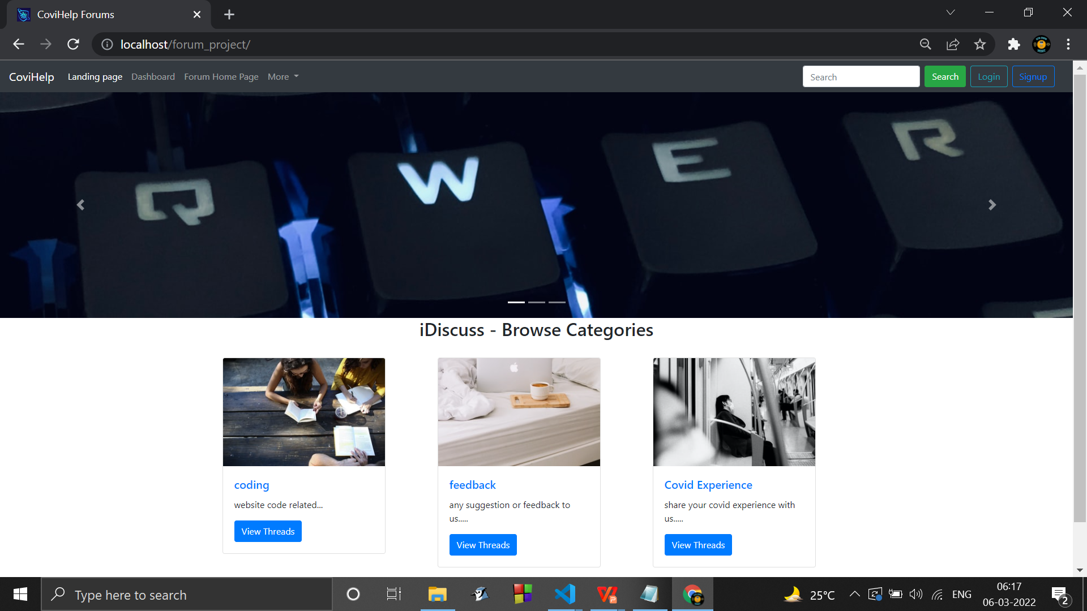
Snapshots of Forum :
After navigating to the forum page from the user dashboard :

Slide 54
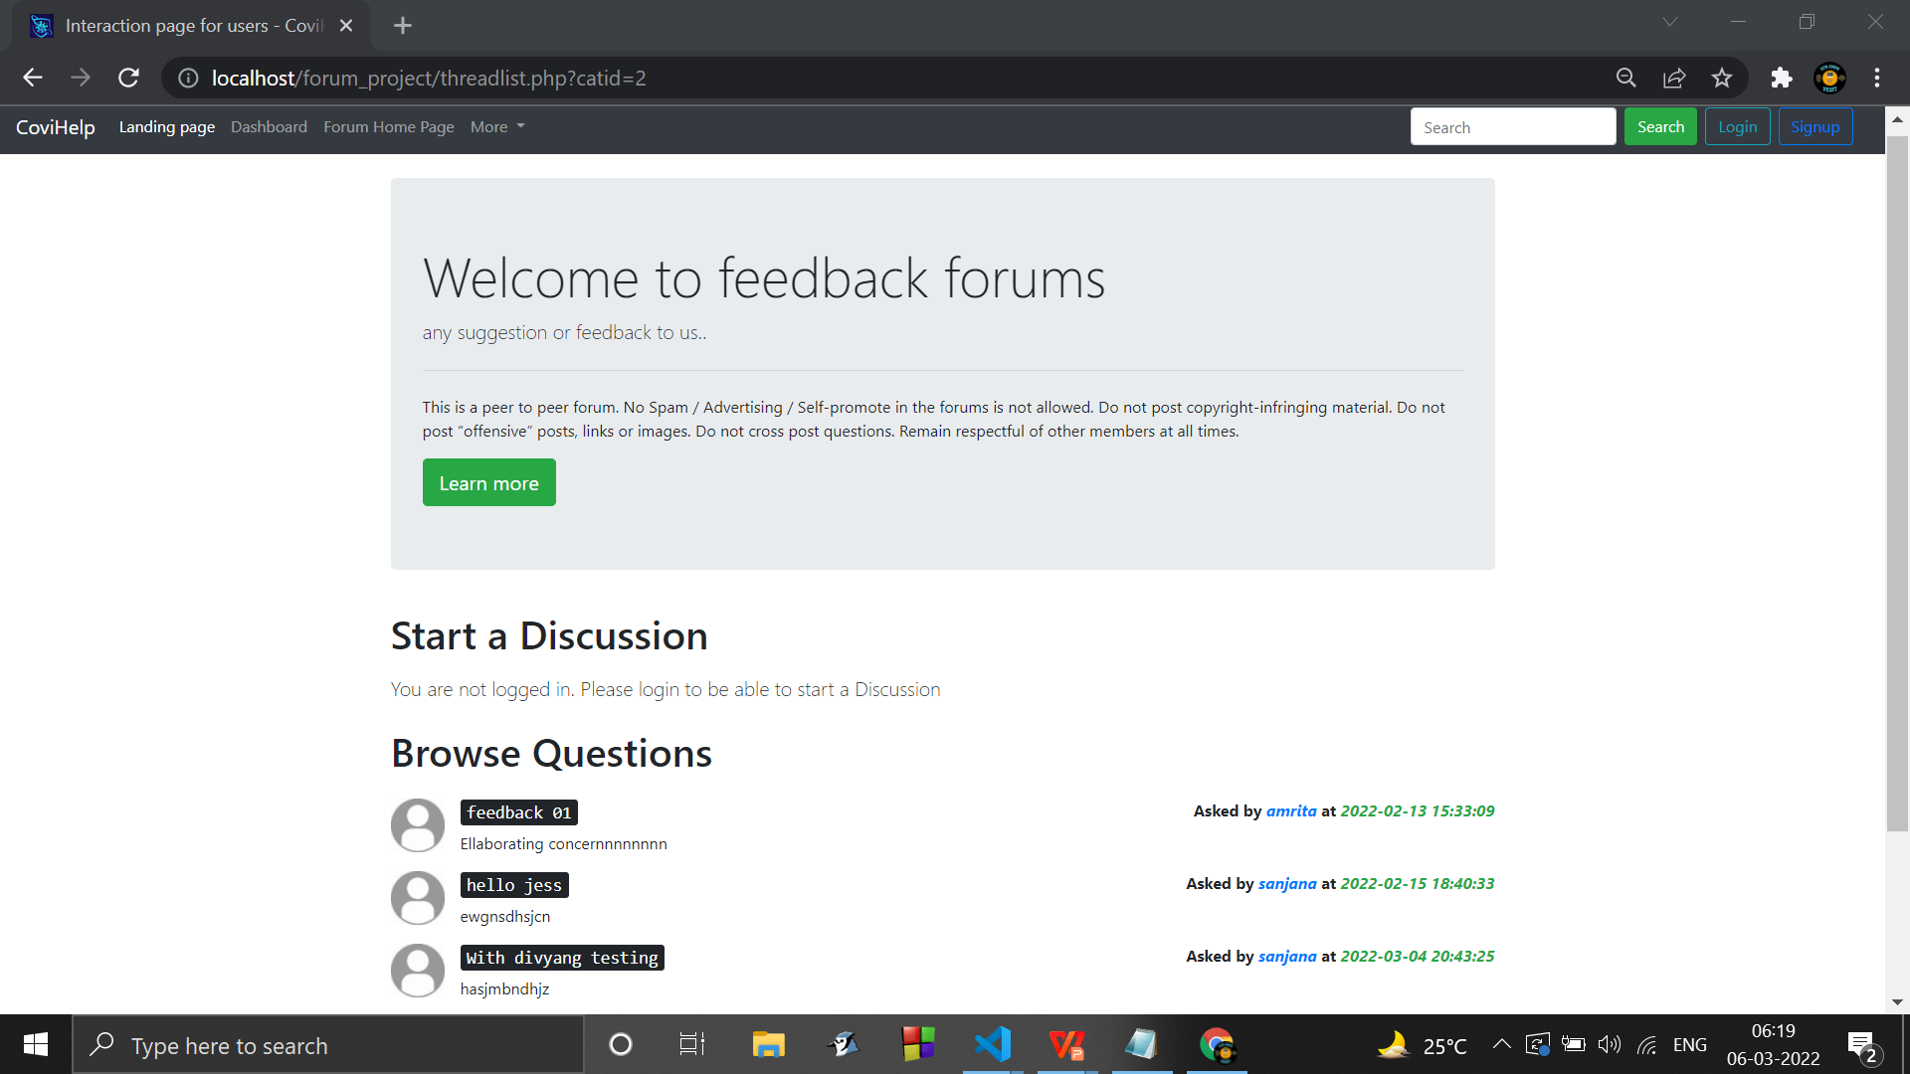
Navigating to Feedback category :

Slide 55
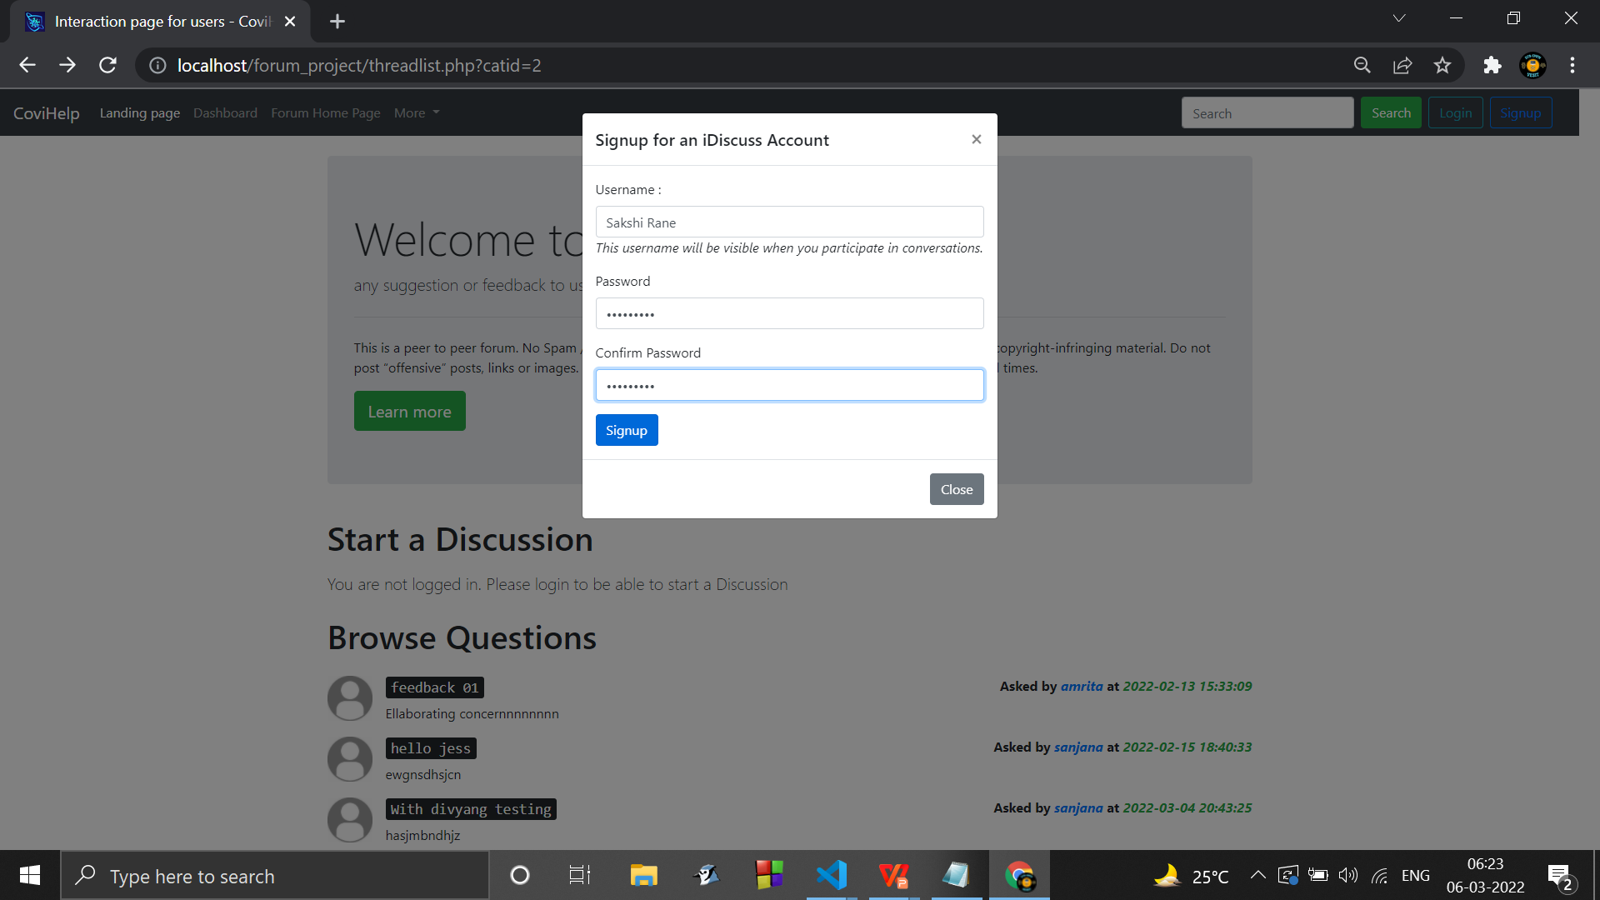
Signing up :
( Now the user has the ability to post )

Slide 56
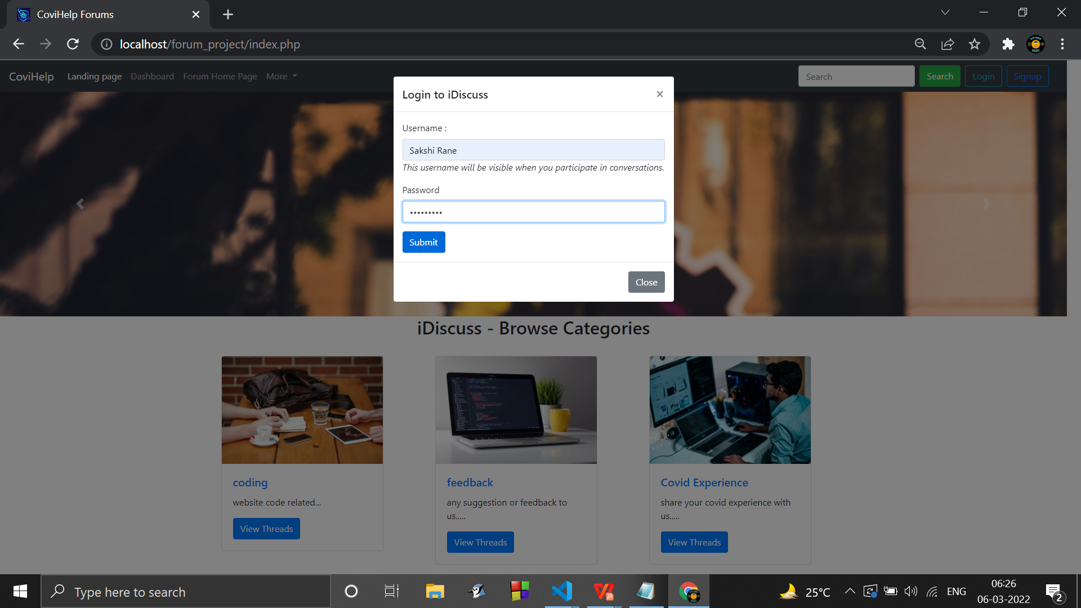
Logging in :

Slide 57
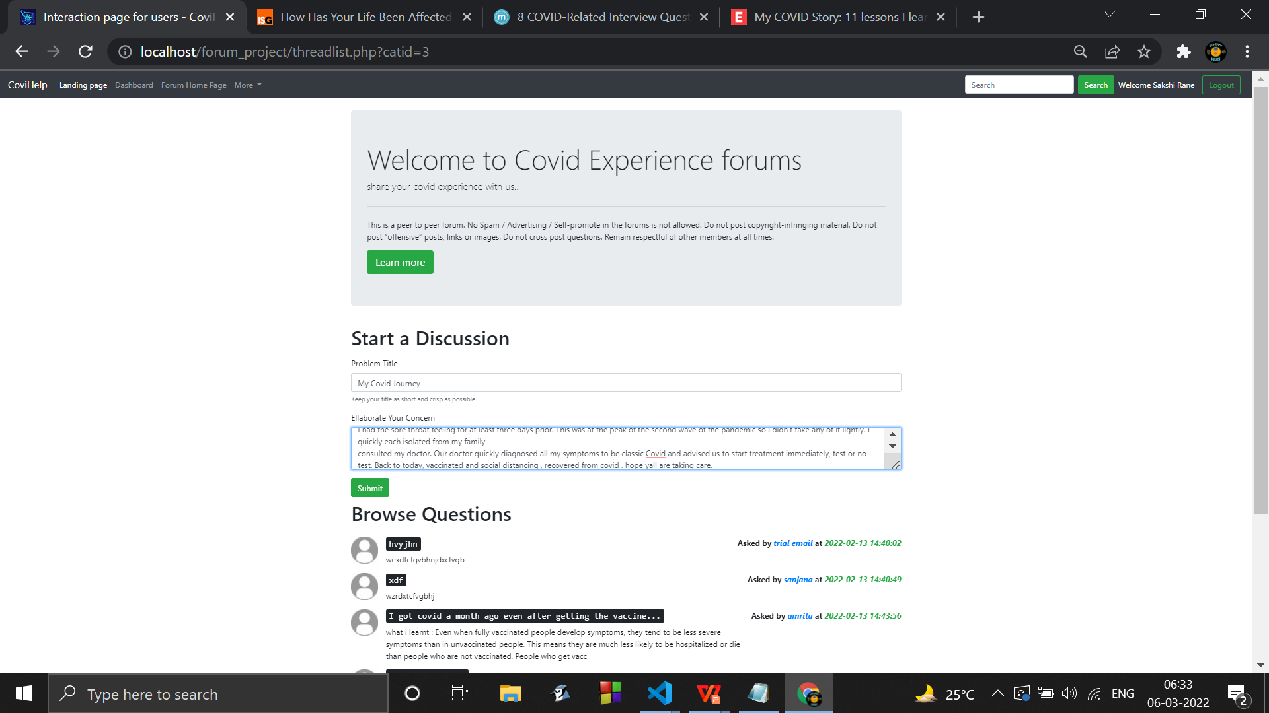
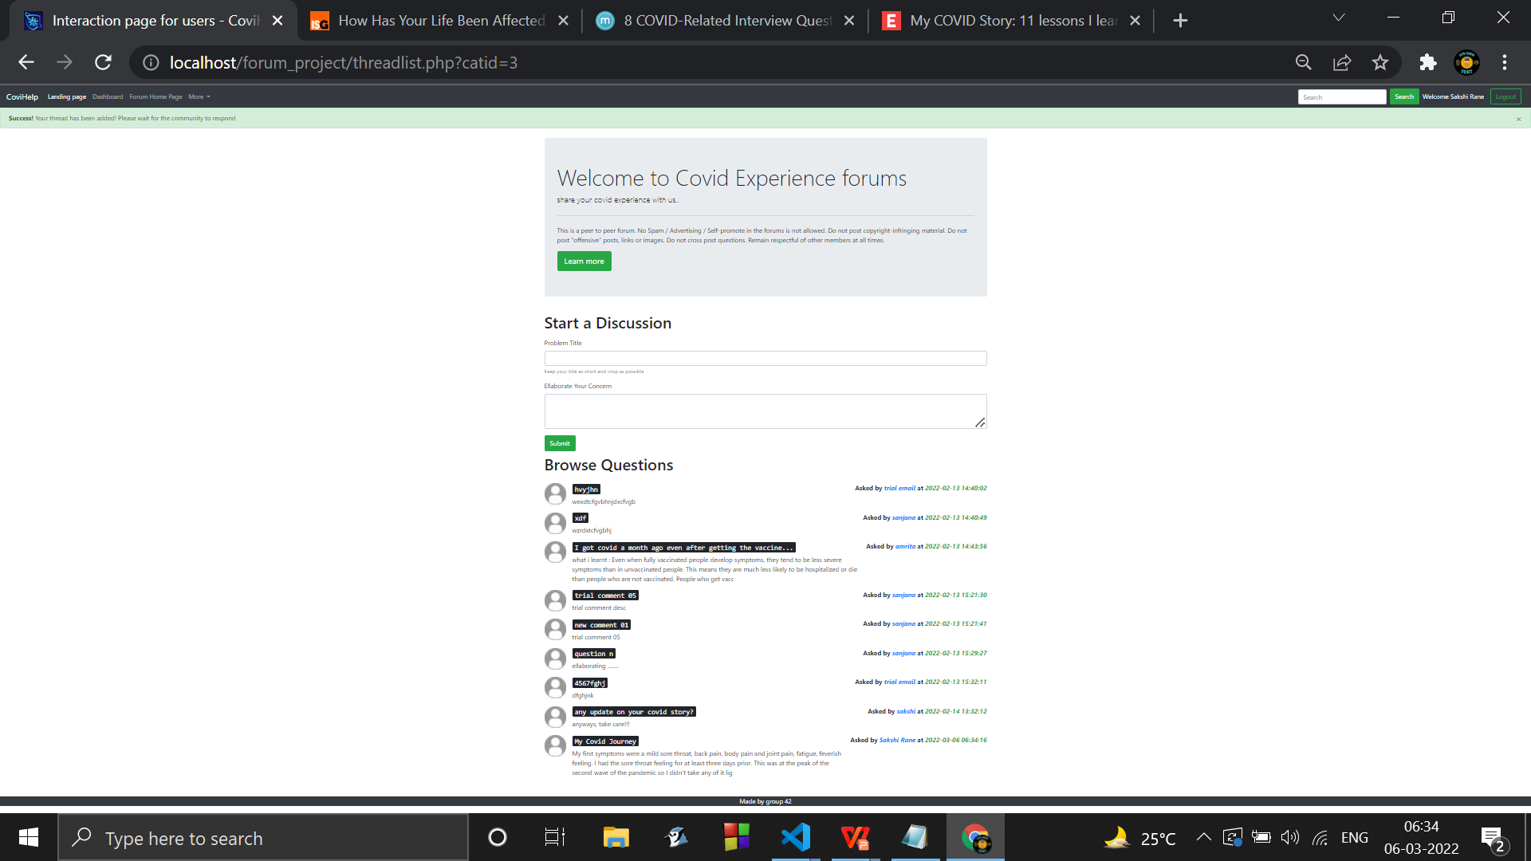
Creating a comment thread :

Slide 58
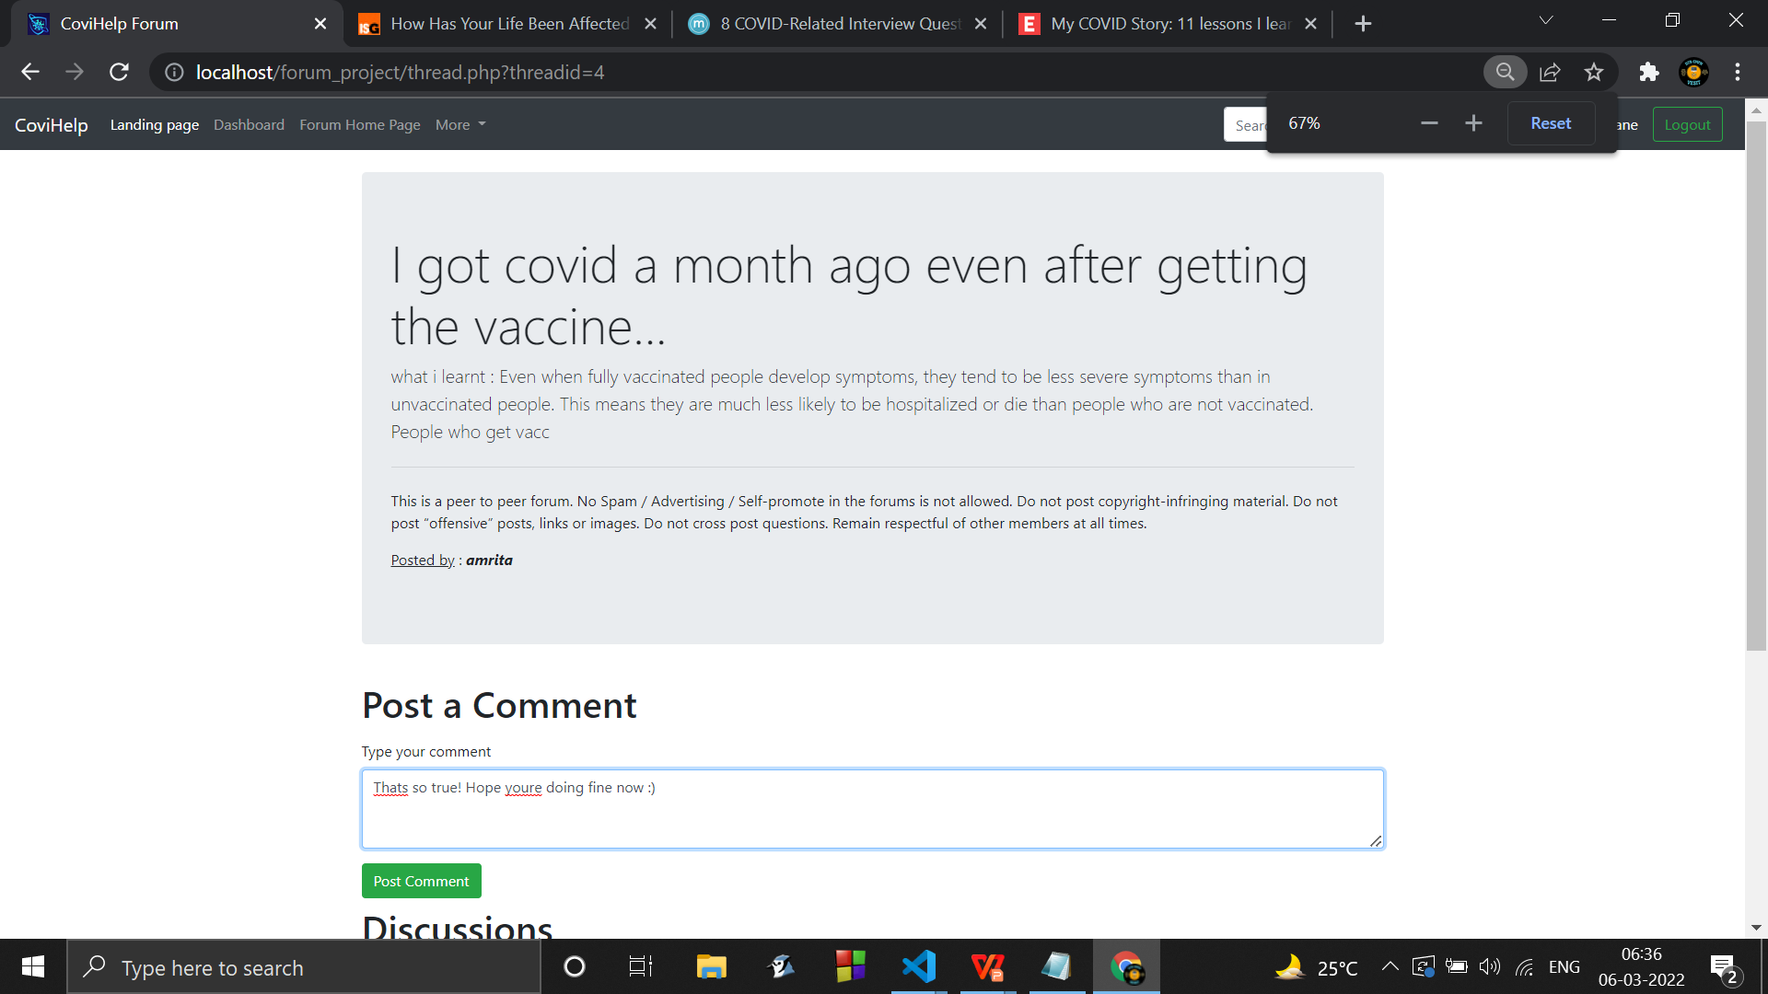
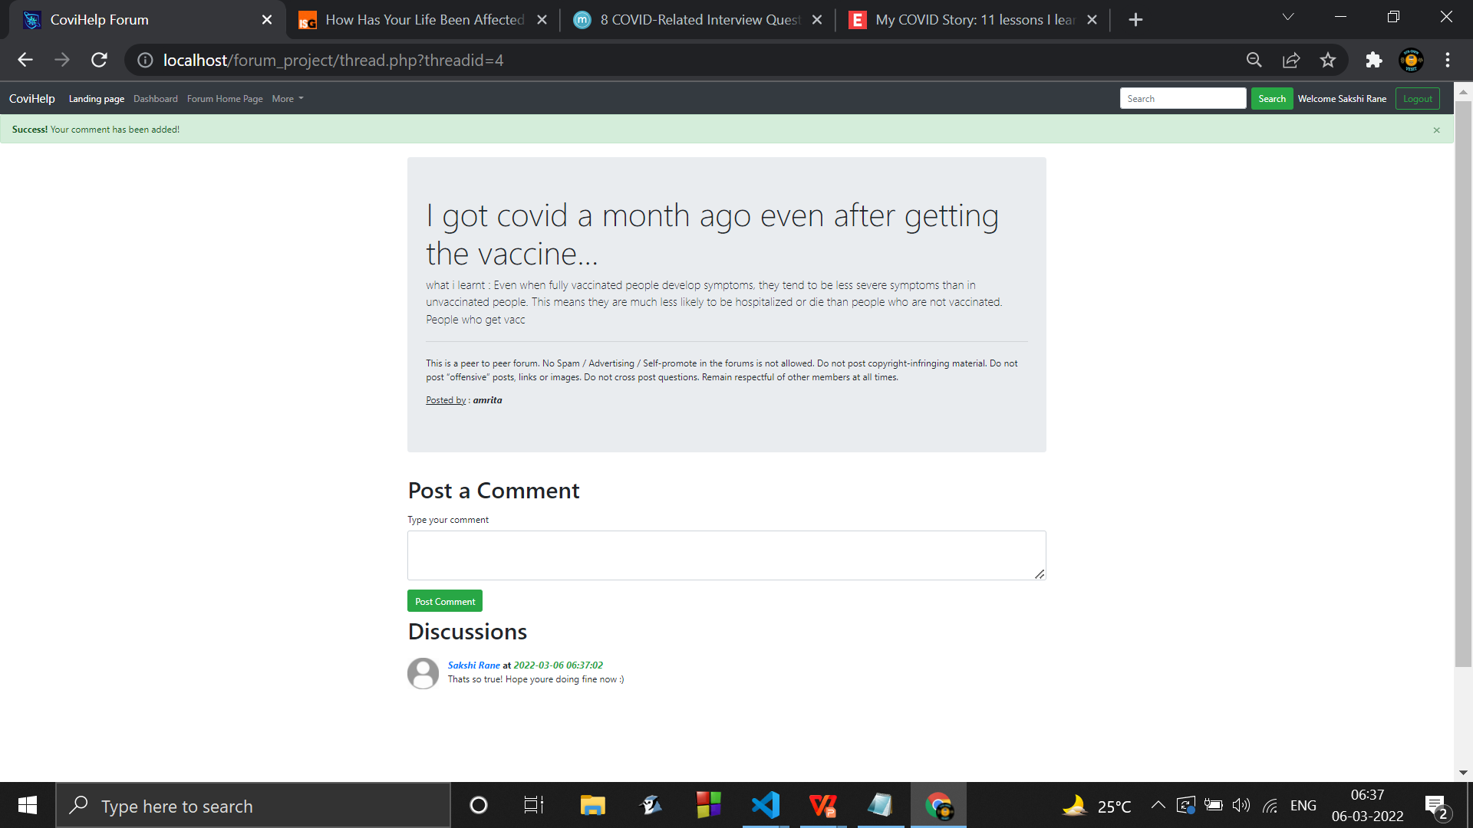
Commenting on threads :

Slide 59
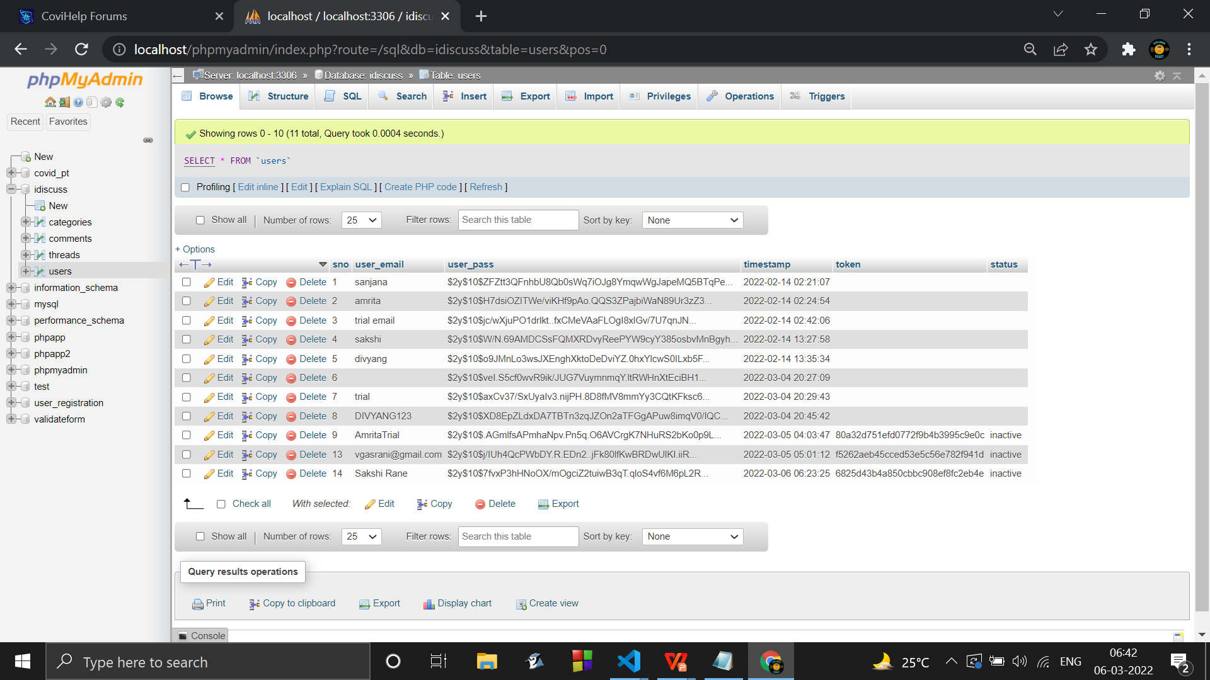
Databases created to implement a forum :

Slide 60
Next Work Plan :
➢Email linking & Generation of a secure link to process a secure login.
➢A 'forgot password' option with the 'remember me ' option and 'show' password.
➢ Use cookies to make sure User gets logged out after a regular period of time .
➢Enhance the UI/UX design.

Slide 61
Conclusion
Thus with the successful implementation of the user interaction page in the form of forum , we conclude here and hope to work on our future work plans and enhance our website .
Thankyou ...

Slide 62
SEM IV REVIEW 2
Additional work implemented since last review :
Email verification Added
Details :
when a user registers , an activation link for our covihelp website is sent to the link specified in the details asked for registration for the same . As soon as the user clicks on that link , the account is valid and the user can login now to access the functionalities.

Slide 63
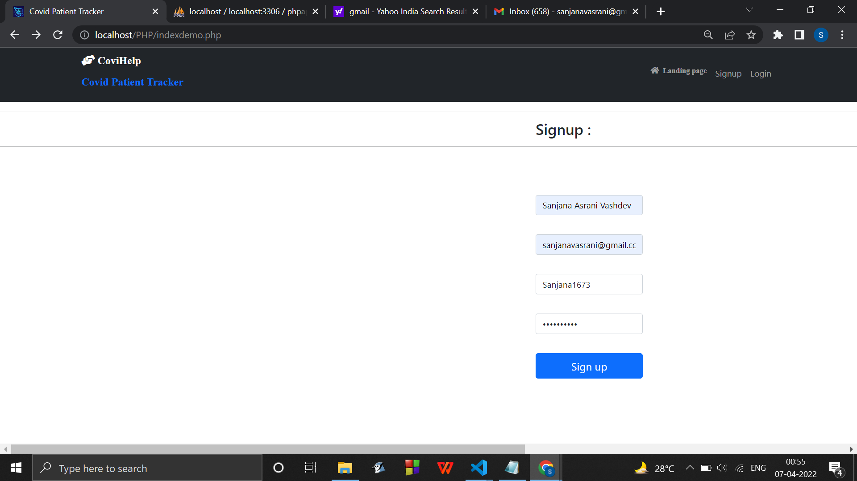
Updated signup page :

Slide 64
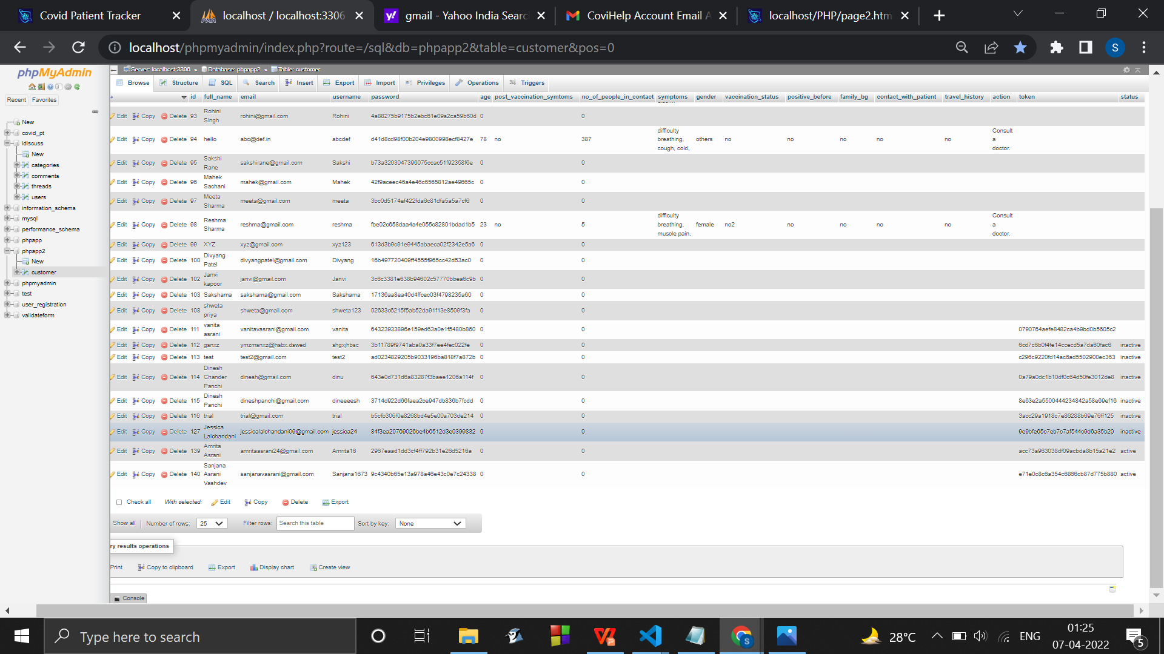
Changes in the database design :
Added columns token & status

Slide 65
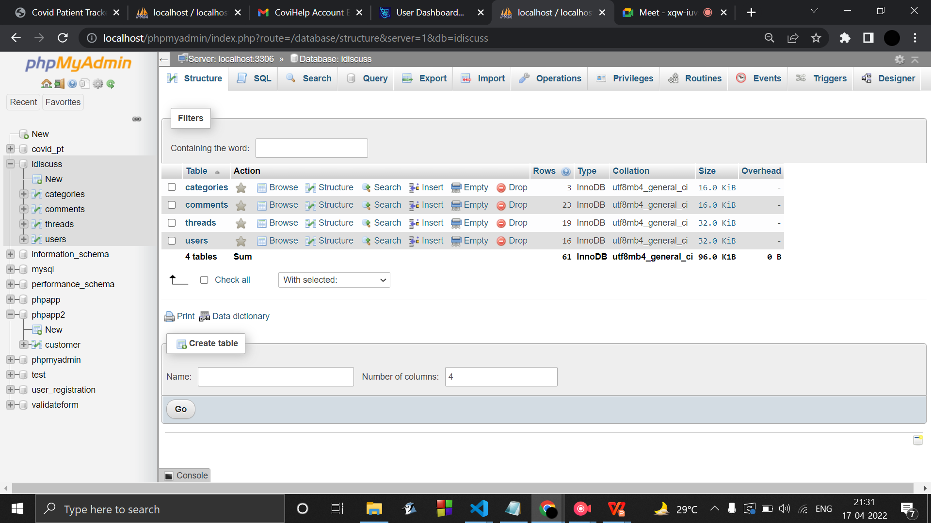
Forum Databases :

Slide 66


Forum for user interaction :

Slide 67


Forum after signup & login :

Slide 68

Email Activation link :

Slide 69

Updated Login page looks like :

Slide 70

Dashboard :

Slide 71

Updating the admin :

Slide 72

Updated dashboard :

Slide 73
Conclusion :
Thus with the addition of email link with the registration page of covihelp website , a safe and secure login can be processed .
Below are some of our future work plans :
Adding forgot password & remember me functionality .
Use of cookies for the same .
Improving the UI/UX design.

